Slide 1
Experiments in image captioning, Wit a twist
The Amusemater Captioner
Joshua Banks Mailman

Slide 2
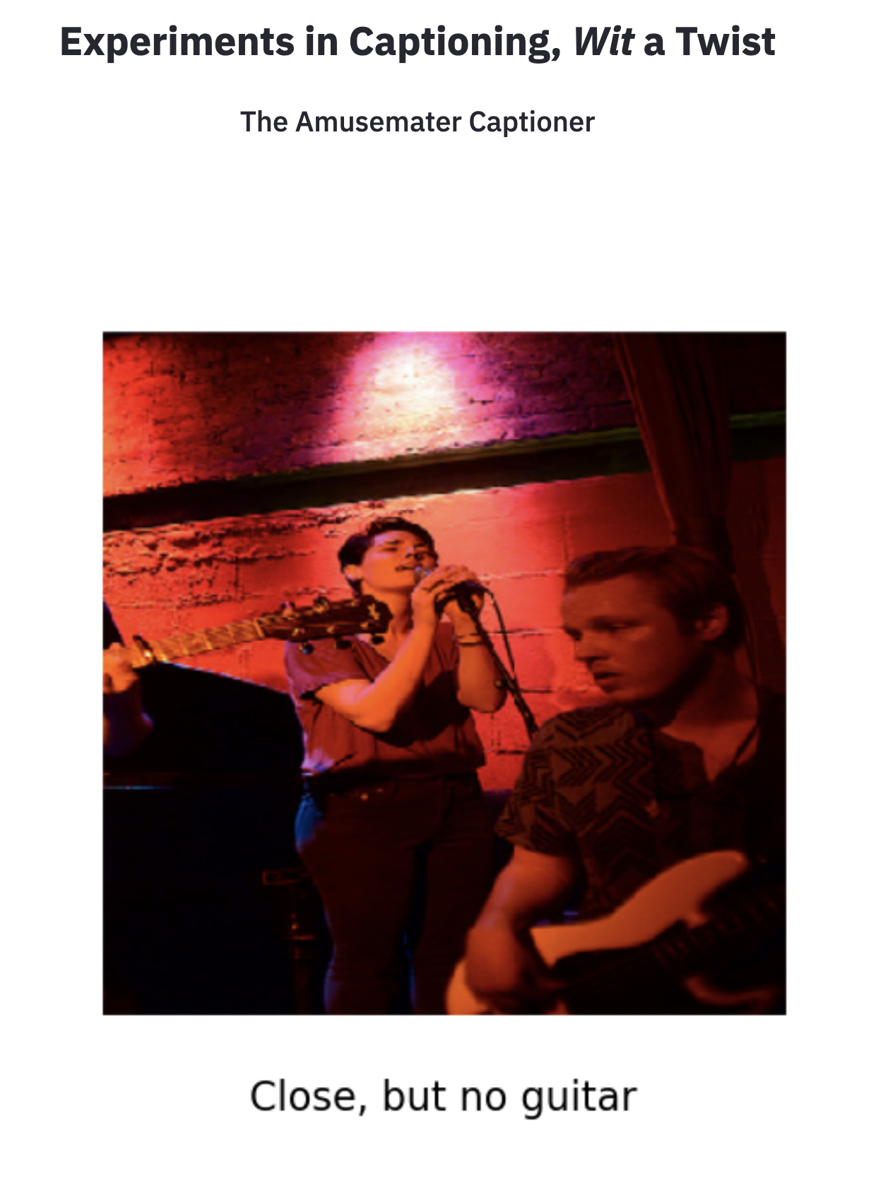

Slide 3
Motivation

Slide 4
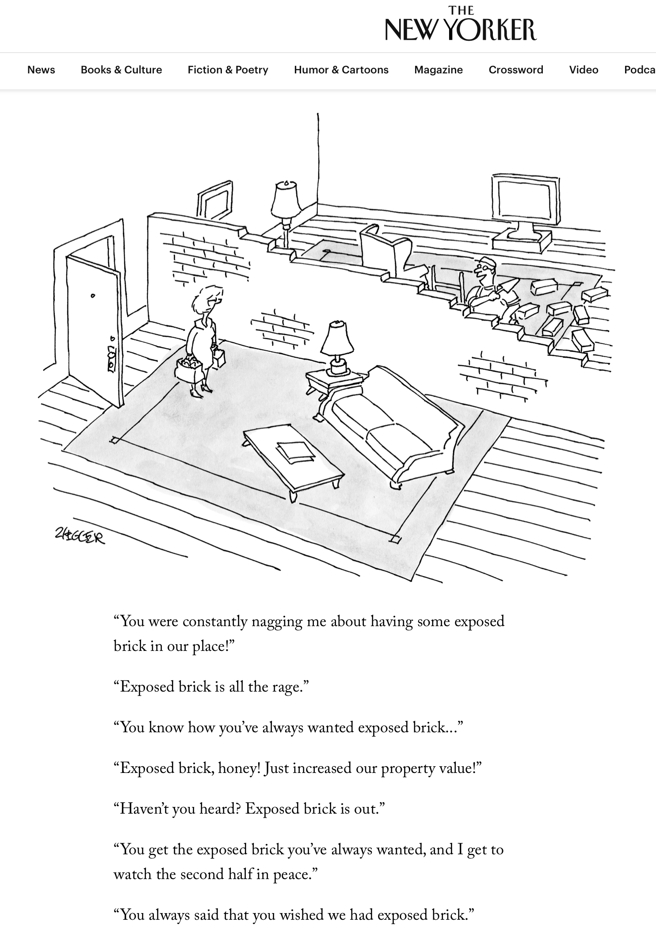
Caption contest

Slide 5
Milton Babbitt’s
titles
Rene Magritte’s titles
It Takes Twelve to Tango
Whirled Series
The Joy of More Sextets
Clairvoyance

Slide 6
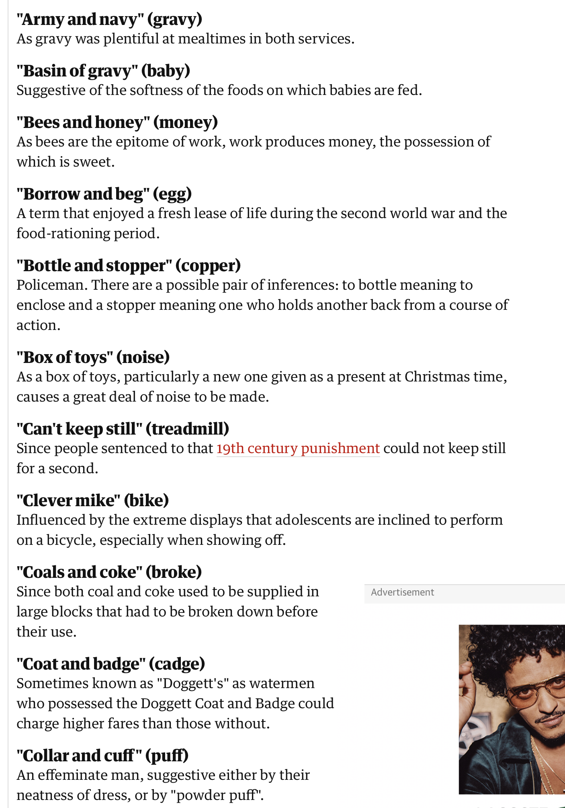
Cockney rhyming slang

Slide 7
Bringing to mind something not literally pictured or mentioned
around the corner
Thinking around the corner
Thinking

Slide 8
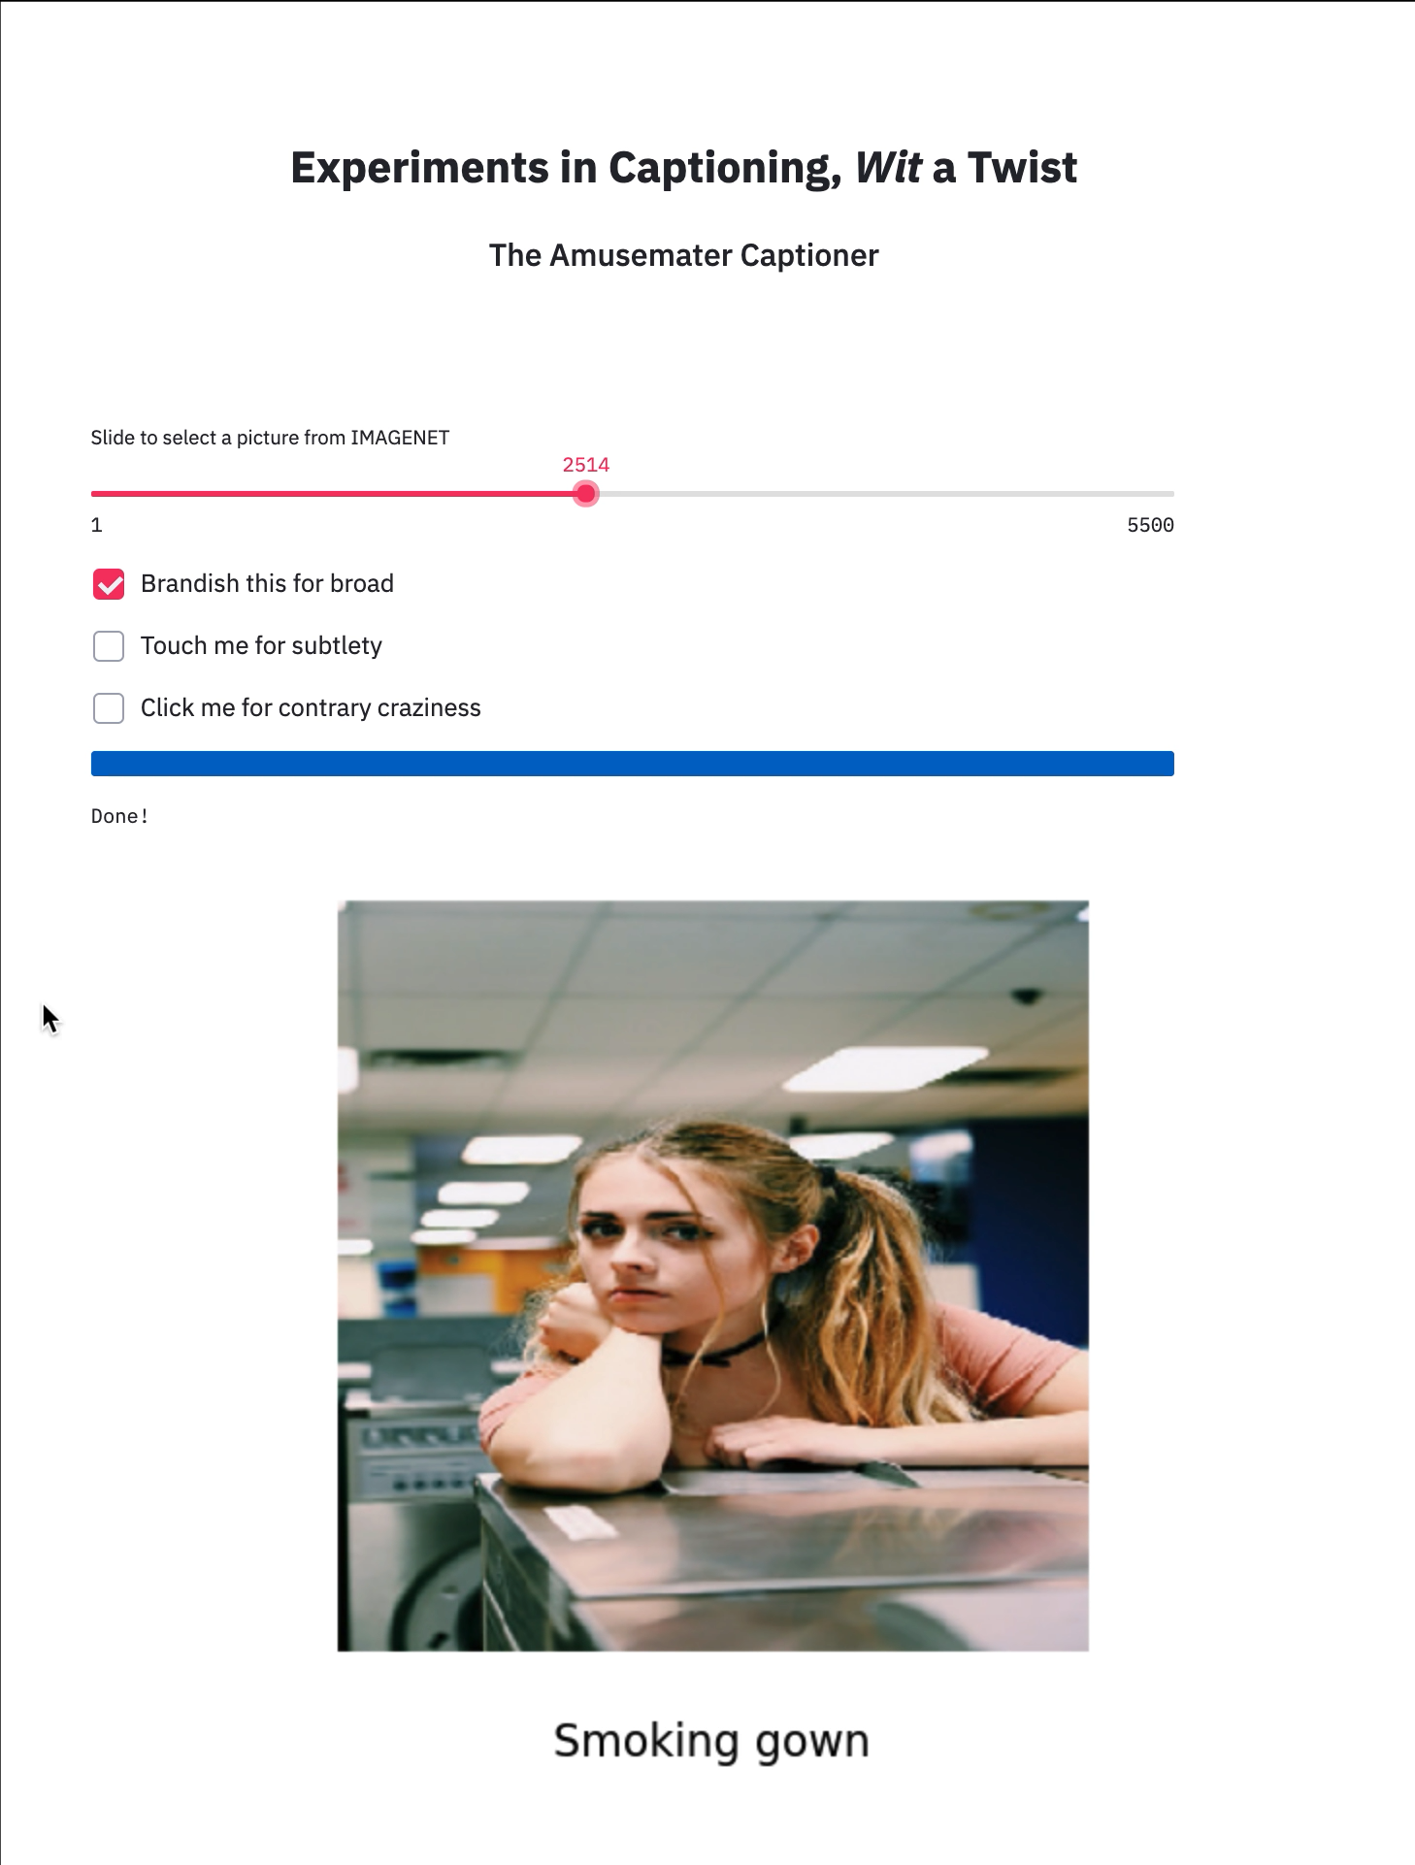
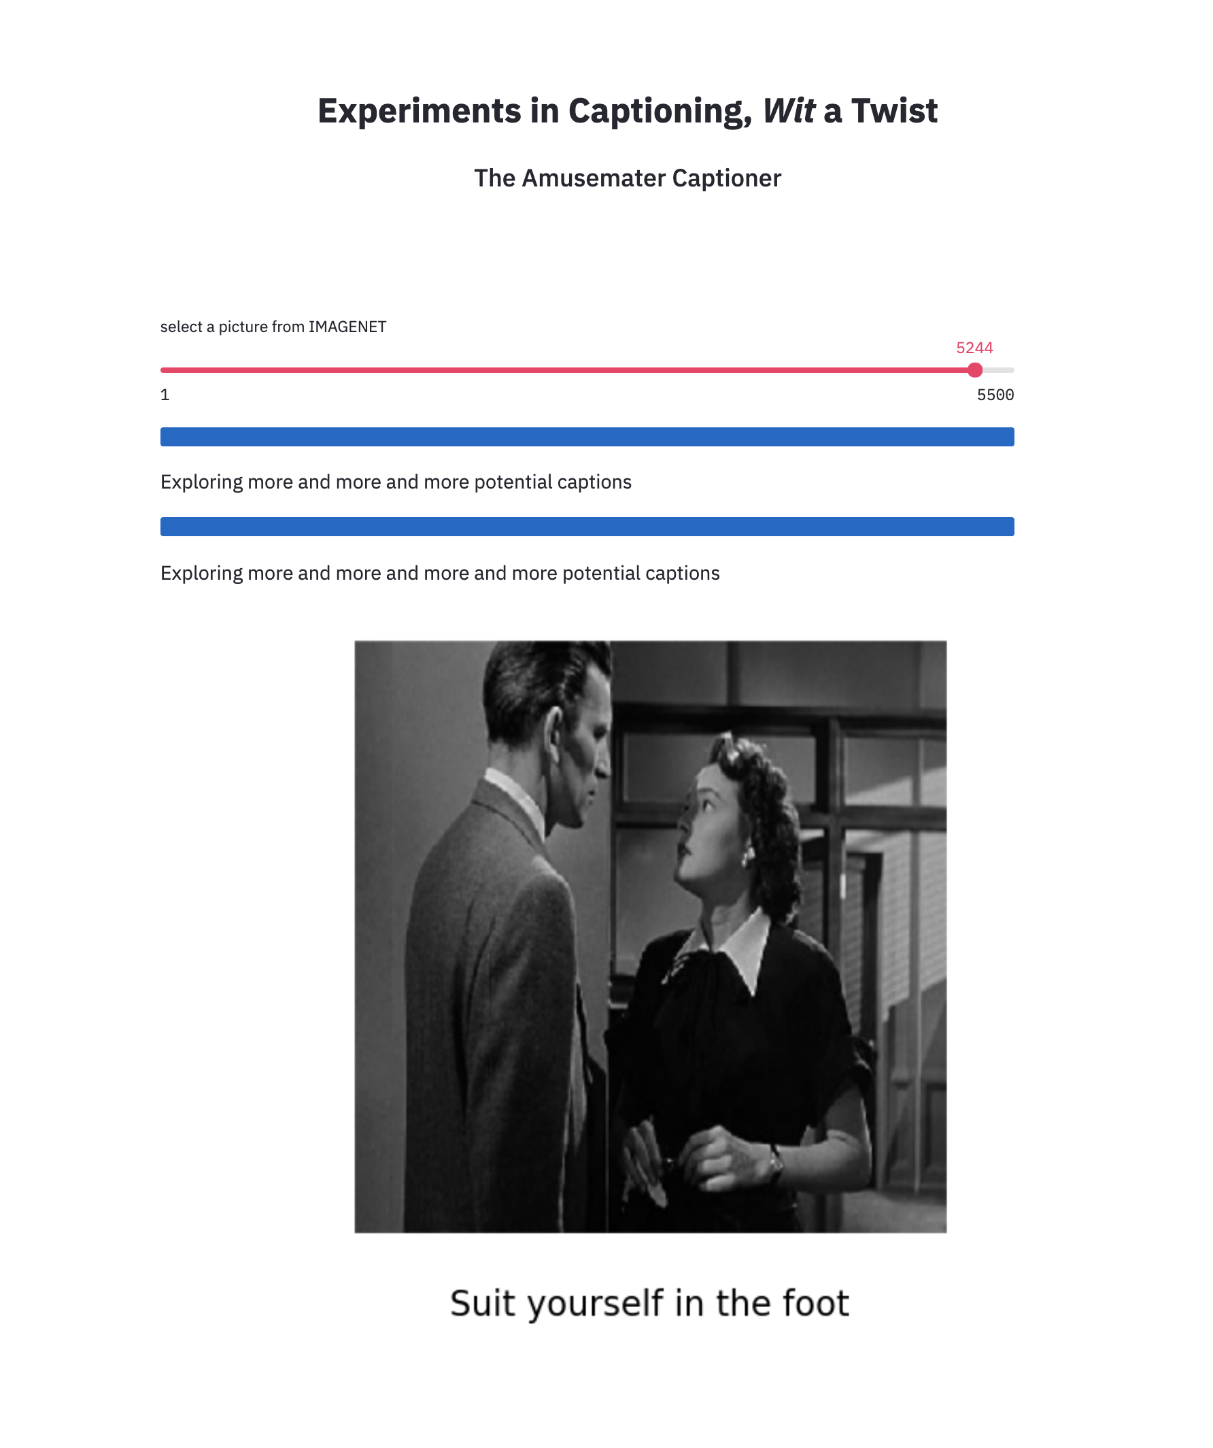

Slide 9
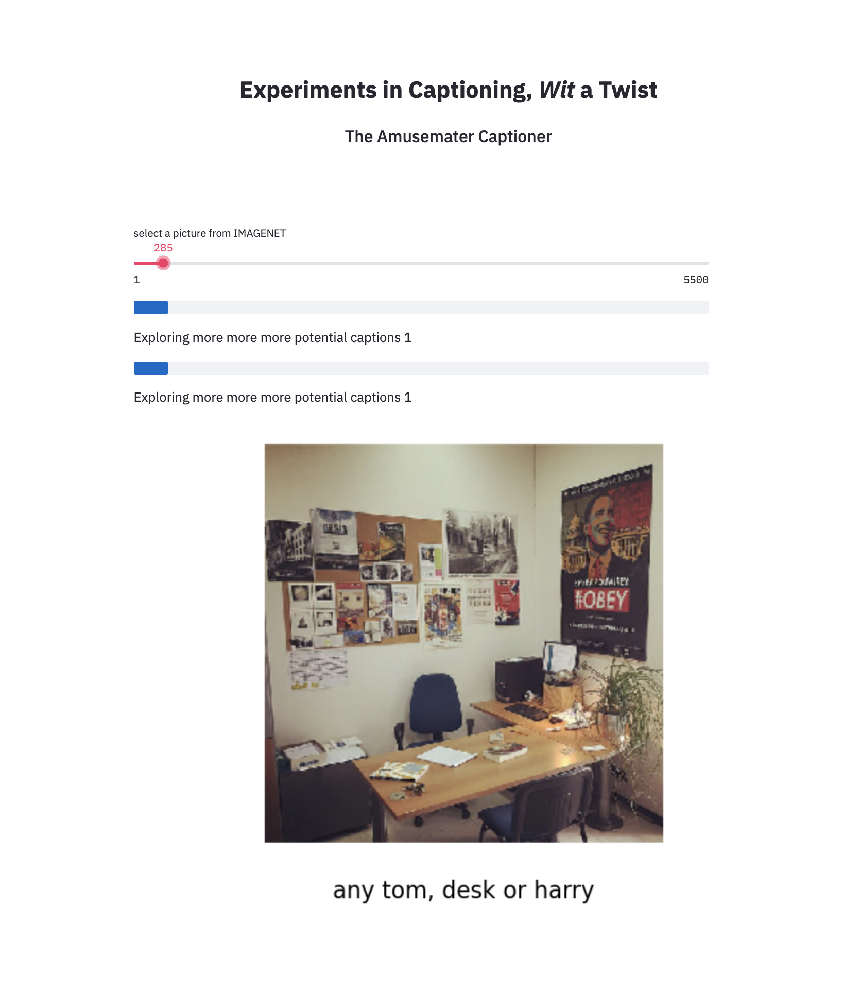
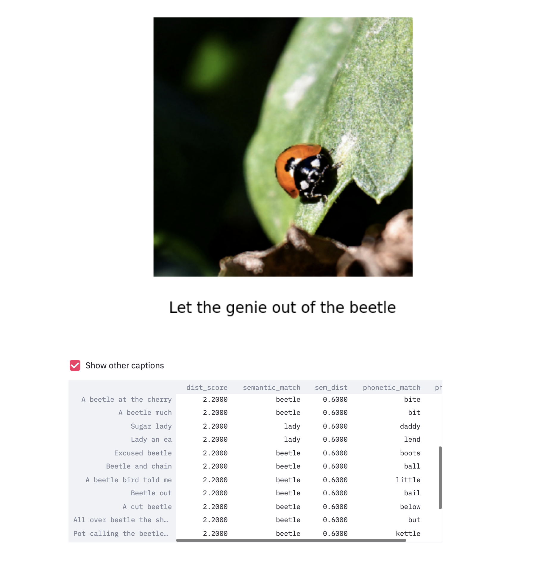

Slide 11
Data Resources
11
More info on how to use this template at www.slidescarnival.com/help-use-presentation-template
This template is free to use under Creative Commons Attribution license. You can keep the Credits slide or mention SlidesCarnival and other resources used in a slide footer.

Slide 12
Data Resources
IMAGENET
5500 with a 1000 labels (categories)
7ESL.com (English as Second Language)
1500 English Idioms
SentiWordNet
>117,000 independent sentences treated as separate documents
Gensim corpuses
Google News
Text 8
“Always a day late and a dollar short”
“They say a cat has nine lives”
“Giving a hundred and ten percent”
CMU (Carnegie Mellon University)
Corpus of English Words
Colloquialize: formal to informal:
“he is” ➔ “he’s”
“do not” ➔ “don’t”
“one will” ➔ “you’ll”
IPA
International Phonetic Alphabet
More info on how to use this template at www.slidescarnival.com/help-use-presentation-template
This template is free to use under Creative Commons Attribution license. You can keep the Credits slide or mention SlidesCarnival and other resources used in a slide footer.

Slide 13
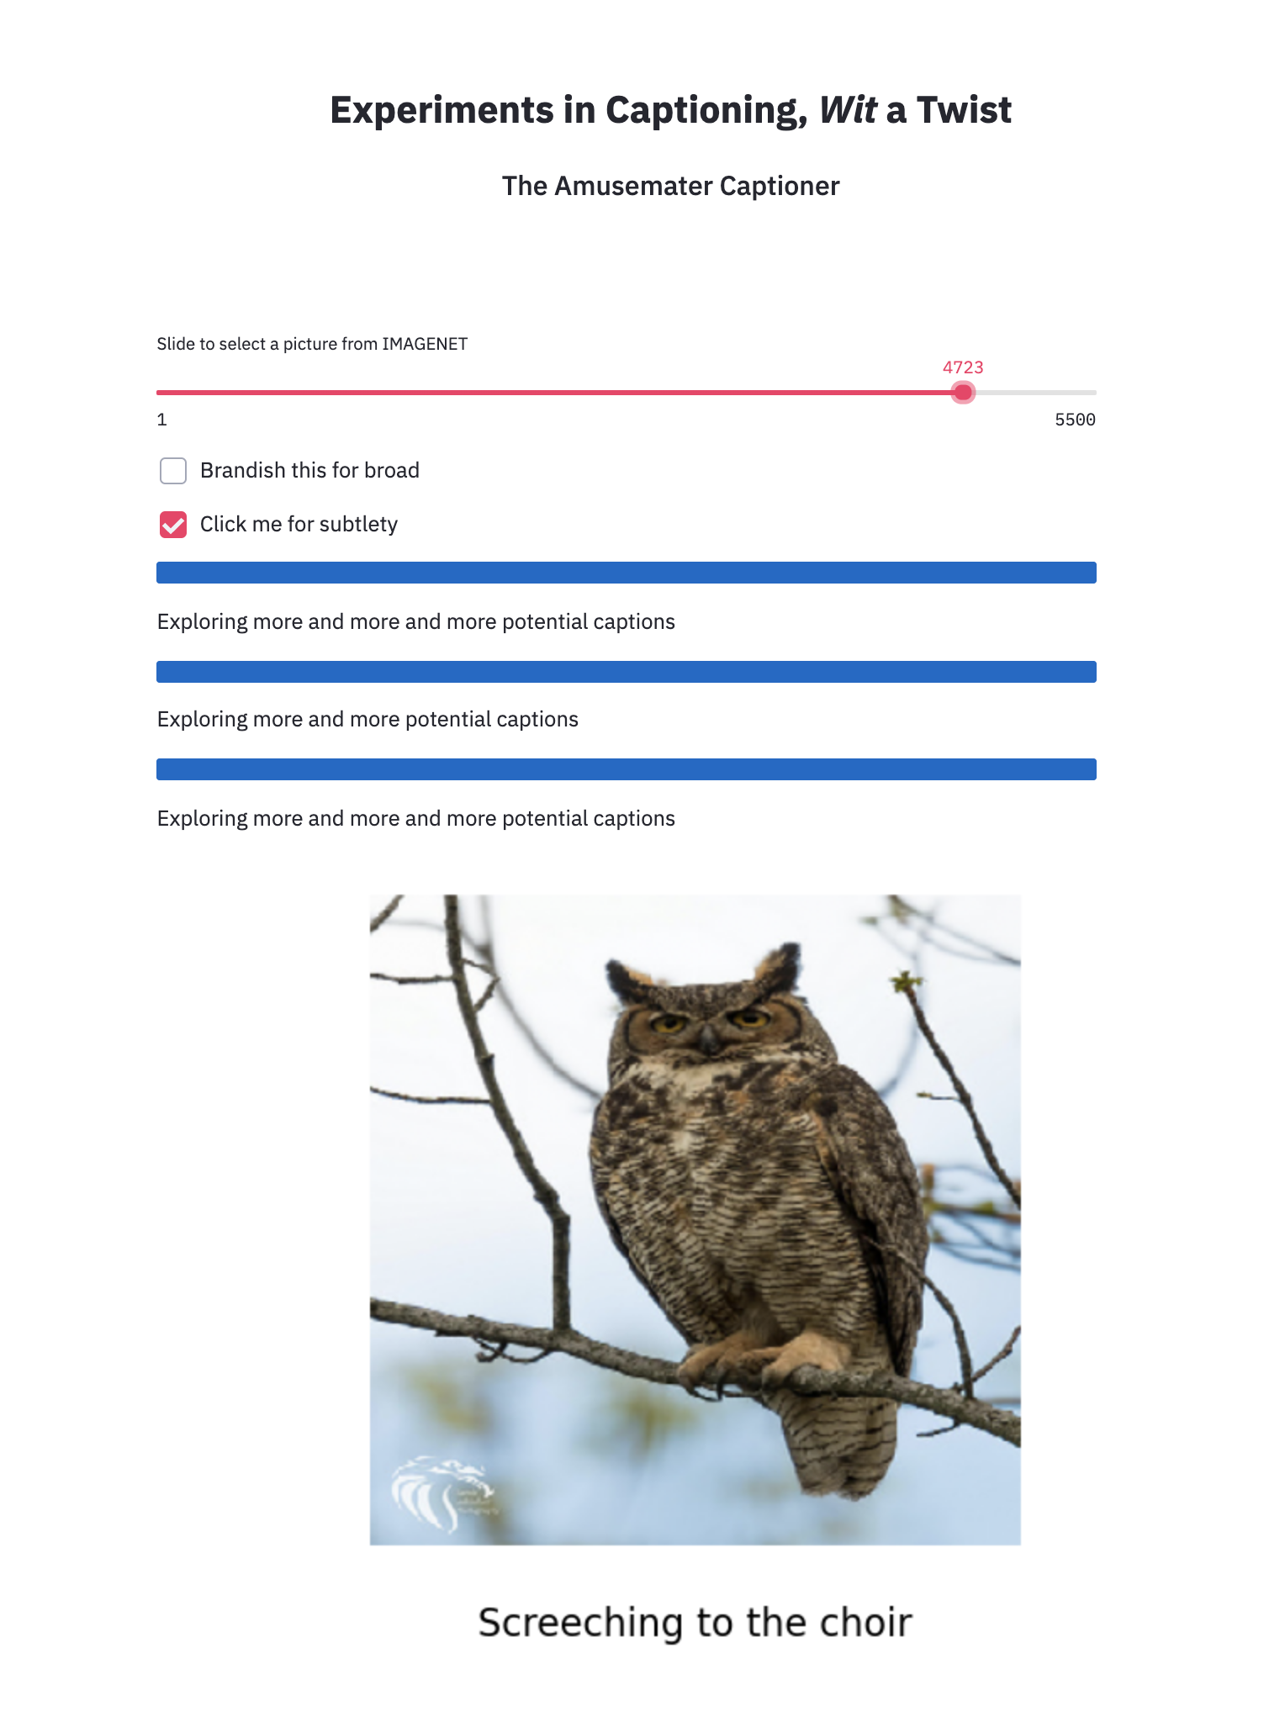
Generate captions referring outside the image

Slide 16
The algorithm and its algorithms
Streamlit
Image
Text
Presentation

Slide 17

Inception
Neural Network
Beautiful Soup
Idioms with a word in one of the phonetic families sorted
. sorted .
. sorted .
Rob
Rob
5500 images from IMAGENET
Xception
Neural Network
Semantic family of words
Idioms with a word in one of the phonetic families
Computed suitability score
1500 English idioms from 7ESL.com
Phonetic families of words
bump
Preaching to the choir
optimal score
all roads lead to rome,, 43624
all sizzle and no steak,, .45789
it's what it's what it was all told,, .48723
It's all the rage,, .46532
not for all the tea in china,, .34765
all things considered,, .45678
clumsy as an ox and ,, .45678
along the lines of what you already heard,, .45555
no need to rush amber gambler,, .45363
the american dream you have heard so much abo43345,
an axe to grind,, .34678
make me an offer you can't refuse,, .34789
like this everything and all that,, .34678
he told everyone and his mother,, .34789
more of this and of that and so forth,, .34893
and so on,, 347890
,,
yes that too and then some,, 34790
lump
what a sight for sore eyes,, .457895
all dressed up and nowhere to go,, .456758
I am all ears,, .456785
all eyes and ears,, .458785
all eyes are on,, .457894
all fur coat and no knickers,, .456784
then all hell breaks loose,, .456438
all in a day's work,, .346484
Glad you arrived all in one piece,, 445678
hmmm, is it really all it's cracked up to be?,, .456876
all over hell's half acre,, .347789
it was all over the map,, .456783
running all over the place,, .456789
all roads lead to rome,, .346789
all sizzle and no steak,, .348473
it's what it's what it was all told,, .304948
It's all the rage,, .345589
,,
stump
stop
stem
stoop
stumble
soup
loots
boots
hoots
hots
hue
whose
Rob
hustle
hooks
bowl
towel
owl
bowel
owl
owe
Screeching to the choir
oil
owe
out
reaching
all roads lead to rome,, .333489
all sizzle and no steak,, .130404
it's what it's what it was all told,, .349384
It's all the rage .343493
not for all the tea in china,, .345566
all things considered,, .345567
clumsy as an ox and ,, .334566
along the lines of what you already heard,, 345675
no need to rush amber gambler,, .344556
the american dream you have heard so much a 44,45
an axe to grind,, .347890
make me an offer you can't refuse,, .344568
like this everything and all that,, 345633
he told everyone and his mother, .345673,
more of this and of that and so forth,, .345675
and so on,, .345466
,,
yes that too and then some,, .344563
Screeching
preaching
what a sight for sore eyes, . 010394,
all dressed up and nowhere to go,, . 010394
I am all ears,, . 010394
all eyes and ears,, . 010394
all eyes are on,, . 010394
all fur coat and no knickers,, . 010394
then all hell breaks loose,, 010394
all in a day's work,, .000349
Glad you arrived all in one piece,, .003483
hmmm, is it really all it's cracked up to be?, .003443
all over hell's half acre,, . 230394
it was all over the map,, . 340394
running all over the place,, .343434
all roads lead to rome,, . 3434k3
all sizzle and no steak,, .345663
it's what it's what it was all told,, 566323
It's all the rage,, 832345
,,
Preaching
to the choir
scratching
screeching
bleaching
screeching
stretching
seeping
screaming
racing
casing
chase
chasing
chaser
chastise
Gensim Word2Vec
basing
NLTK Synset
TF-IDF corr matrix
choosing
Phonetics APIs:
• English-to-IPA,
• Pronunciation,
• Phonetics
BOW & Skip-gram
CMU
corpus
SentiWordNet
corpus
Google News &
Text8 corpuses
Gensim Word2Vec

Slide 18
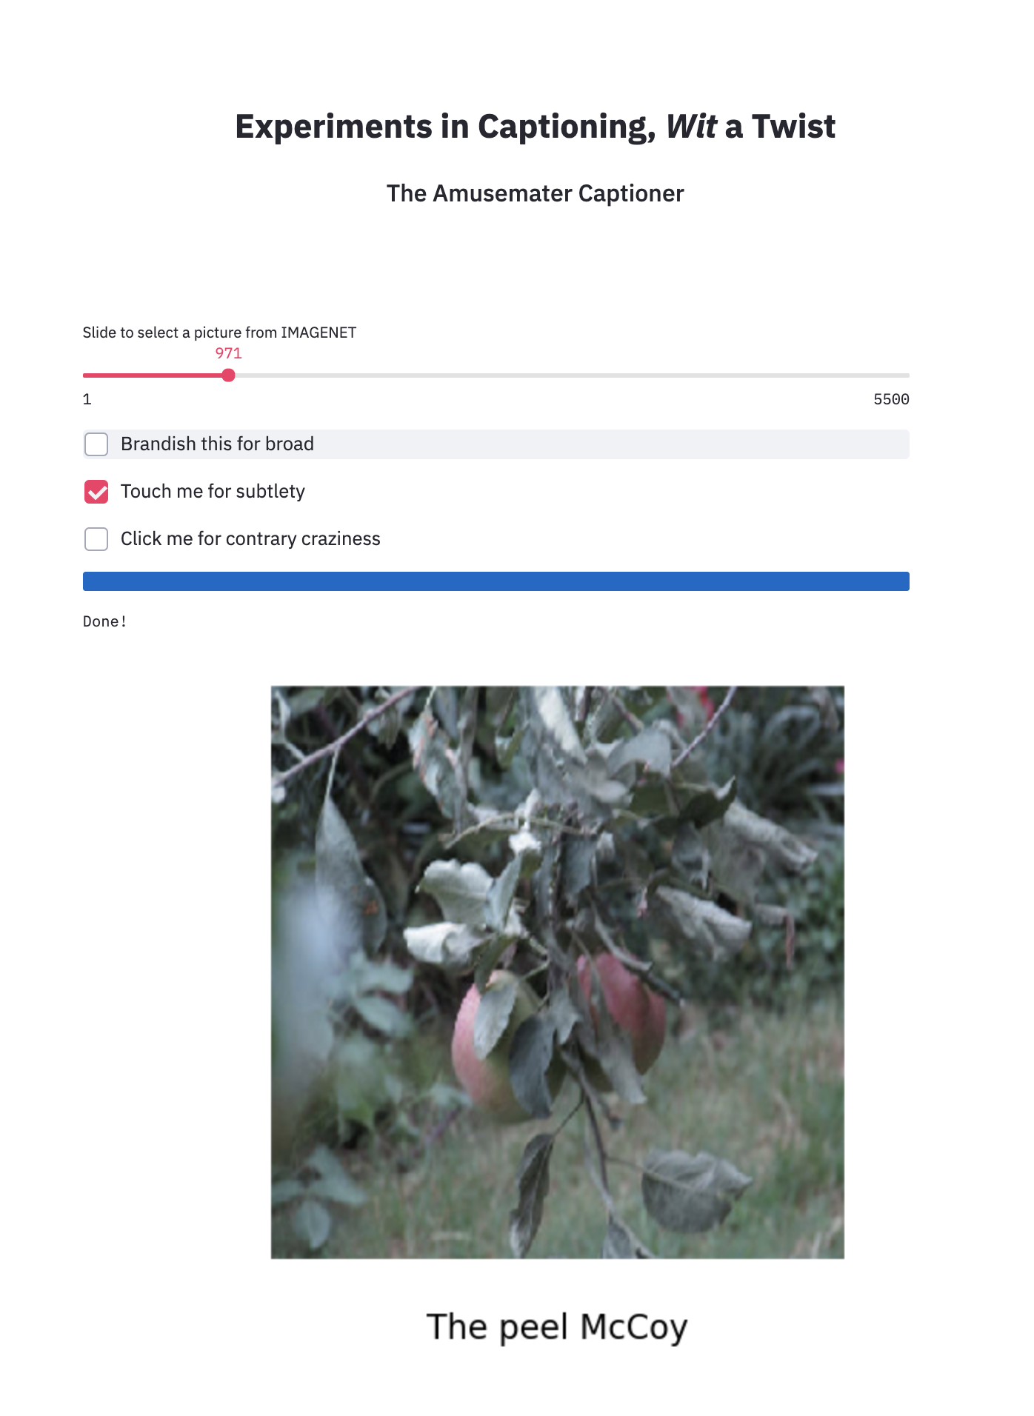
Streamlit

Slide 19
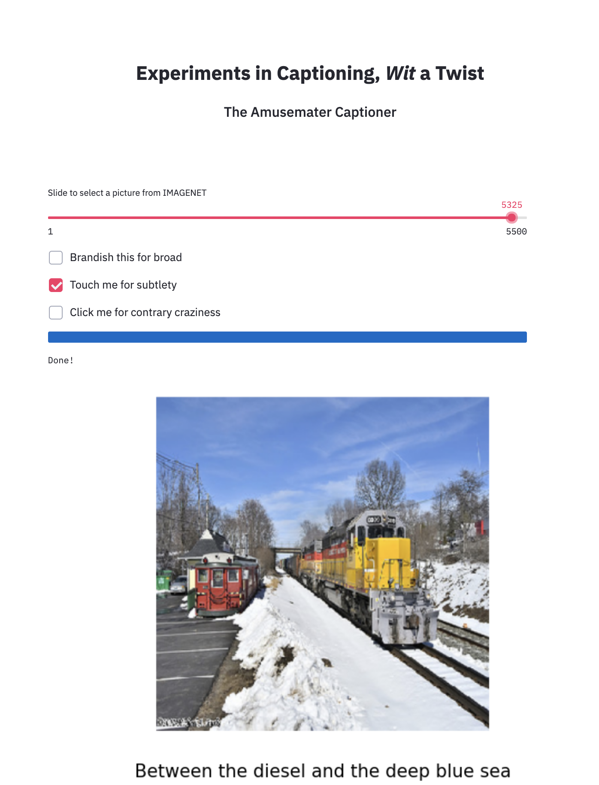
Streamlit

Slide 20
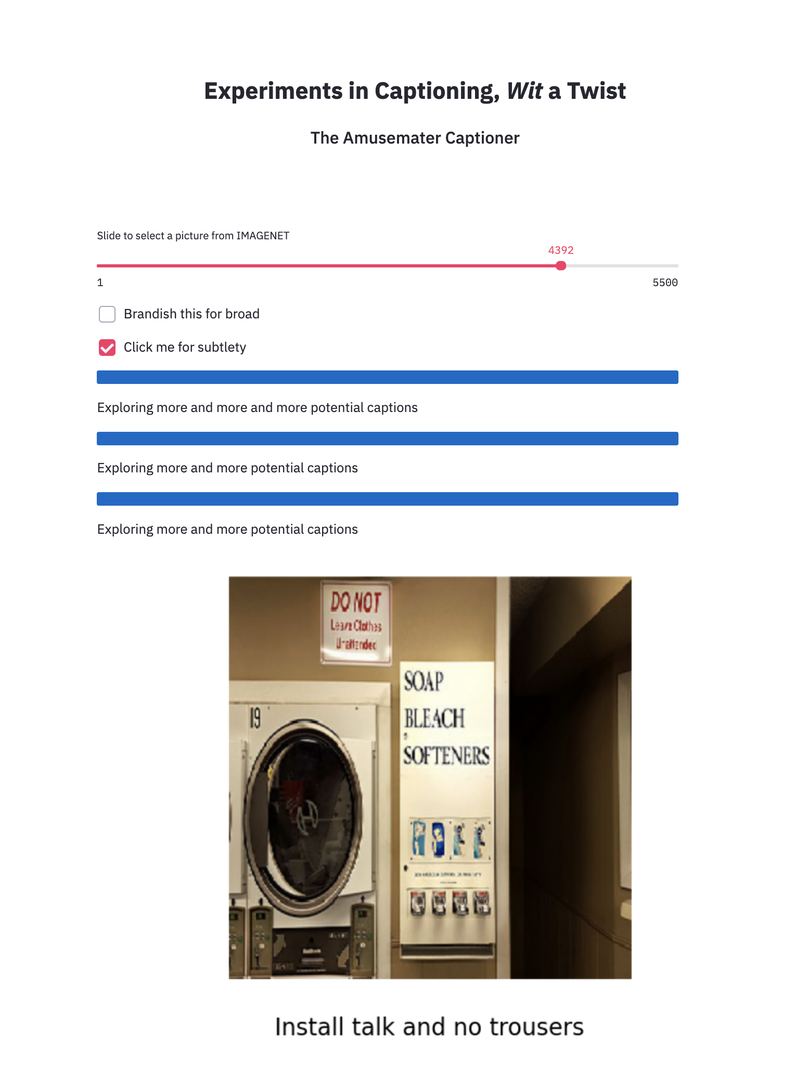
Streamlit

Slide 21
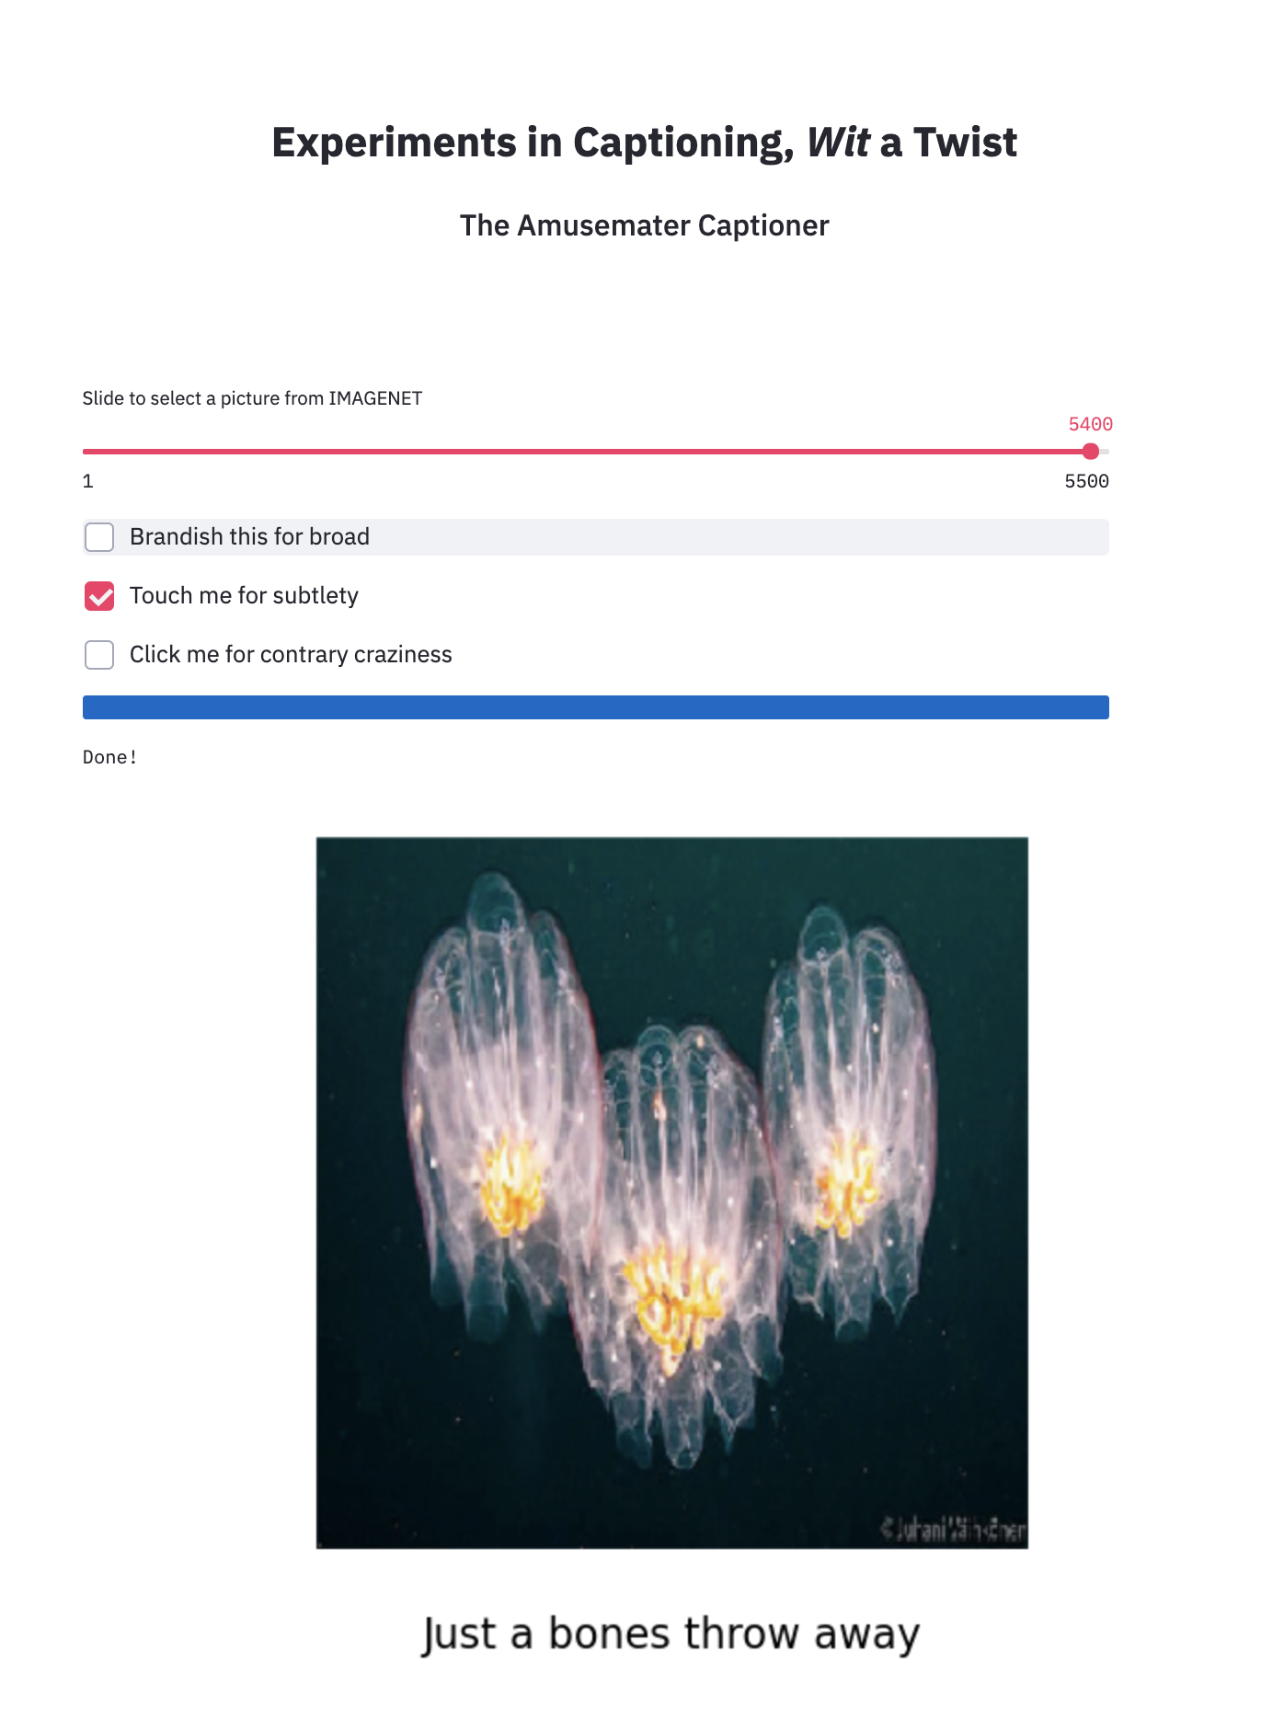

Slide 22
Experiments in image captioning, Wit a twist
The Amusemater Captioner
joshuabanksmailman@gmail.com
Joshua Banks Mailman
https://twitter.com/JoshuaBMailman
https://github.com/jmailman
https://www.linkedin.com/in/joshua-banks-mailman/

Slide 23
Blue is the colour of the clear sky and the deep sea
Red is the colour of danger and courage
Black is the color of ebony and of outer space
Yellow is the color of gold, butter and ripe lemons
White is the color of milk and fresh snow
Blue is the colour of the clear sky and the deep sea
JAN
FEB
MAR
APR
MAY
JUN
JUL
AUG
SEP
OCT
NOV
DEC
Yellow is the color of gold, butter and ripe lemons
White is the color of milk and fresh snow
Blue is the colour of the clear sky and the deep sea
Red is the colour of danger and courage
Black is the color of ebony and of outer space
Yellow is the color of gold, butter and ripe lemons

Slide 24
Appendix
Blue is the colour of the clear sky and the deep sea
Red is the colour of danger and courage
Black is the color of ebony and of outer space
Yellow is the color of gold, butter and ripe lemons
White is the color of milk and fresh snow
Blue is the colour of the clear sky and the deep sea
JAN
FEB
MAR
APR
MAY
JUN
JUL
AUG
SEP
OCT
NOV
DEC
Yellow is the color of gold, butter and ripe lemons
White is the color of milk and fresh snow
Blue is the colour of the clear sky and the deep sea
Red is the colour of danger and courage
Black is the color of ebony and of outer space
Yellow is the color of gold, butter and ripe lemons

Slide 26
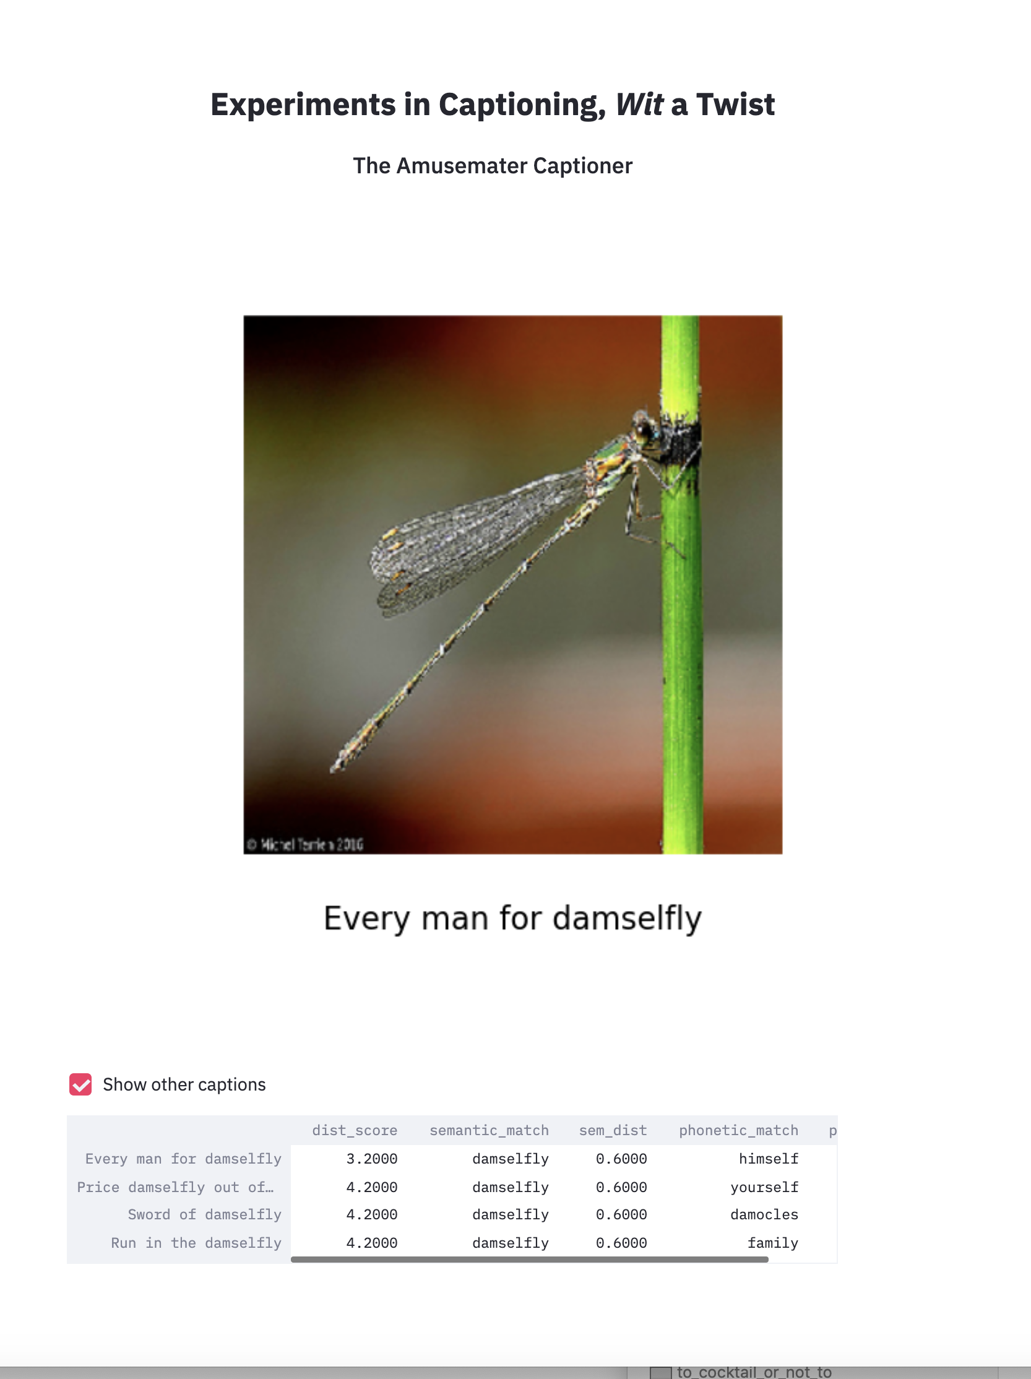

Slide 27
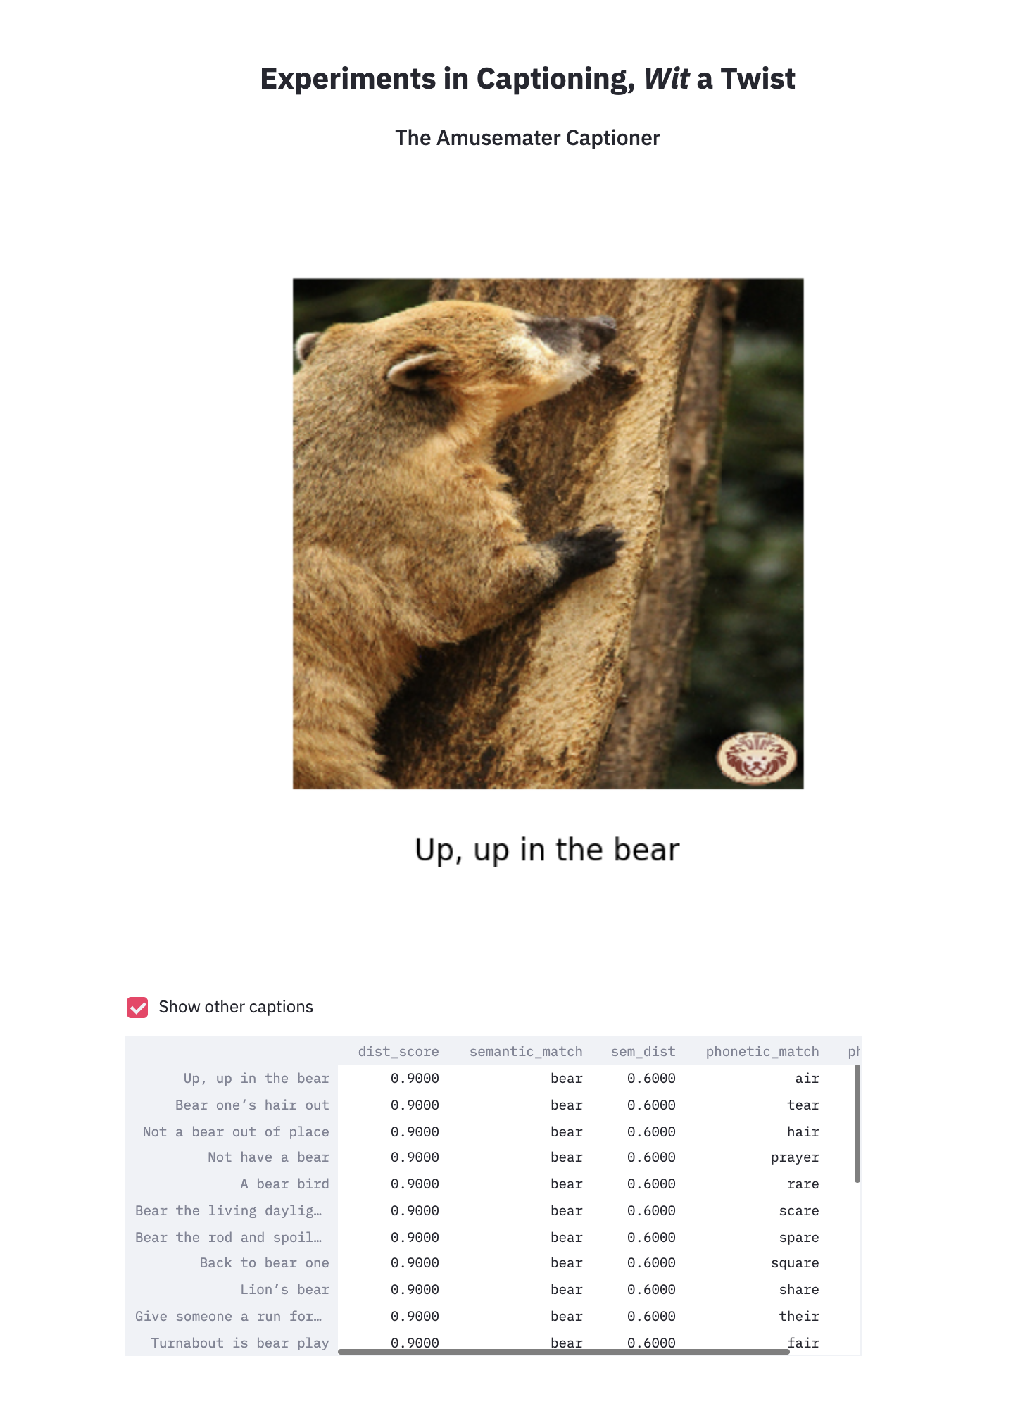

Slide 28
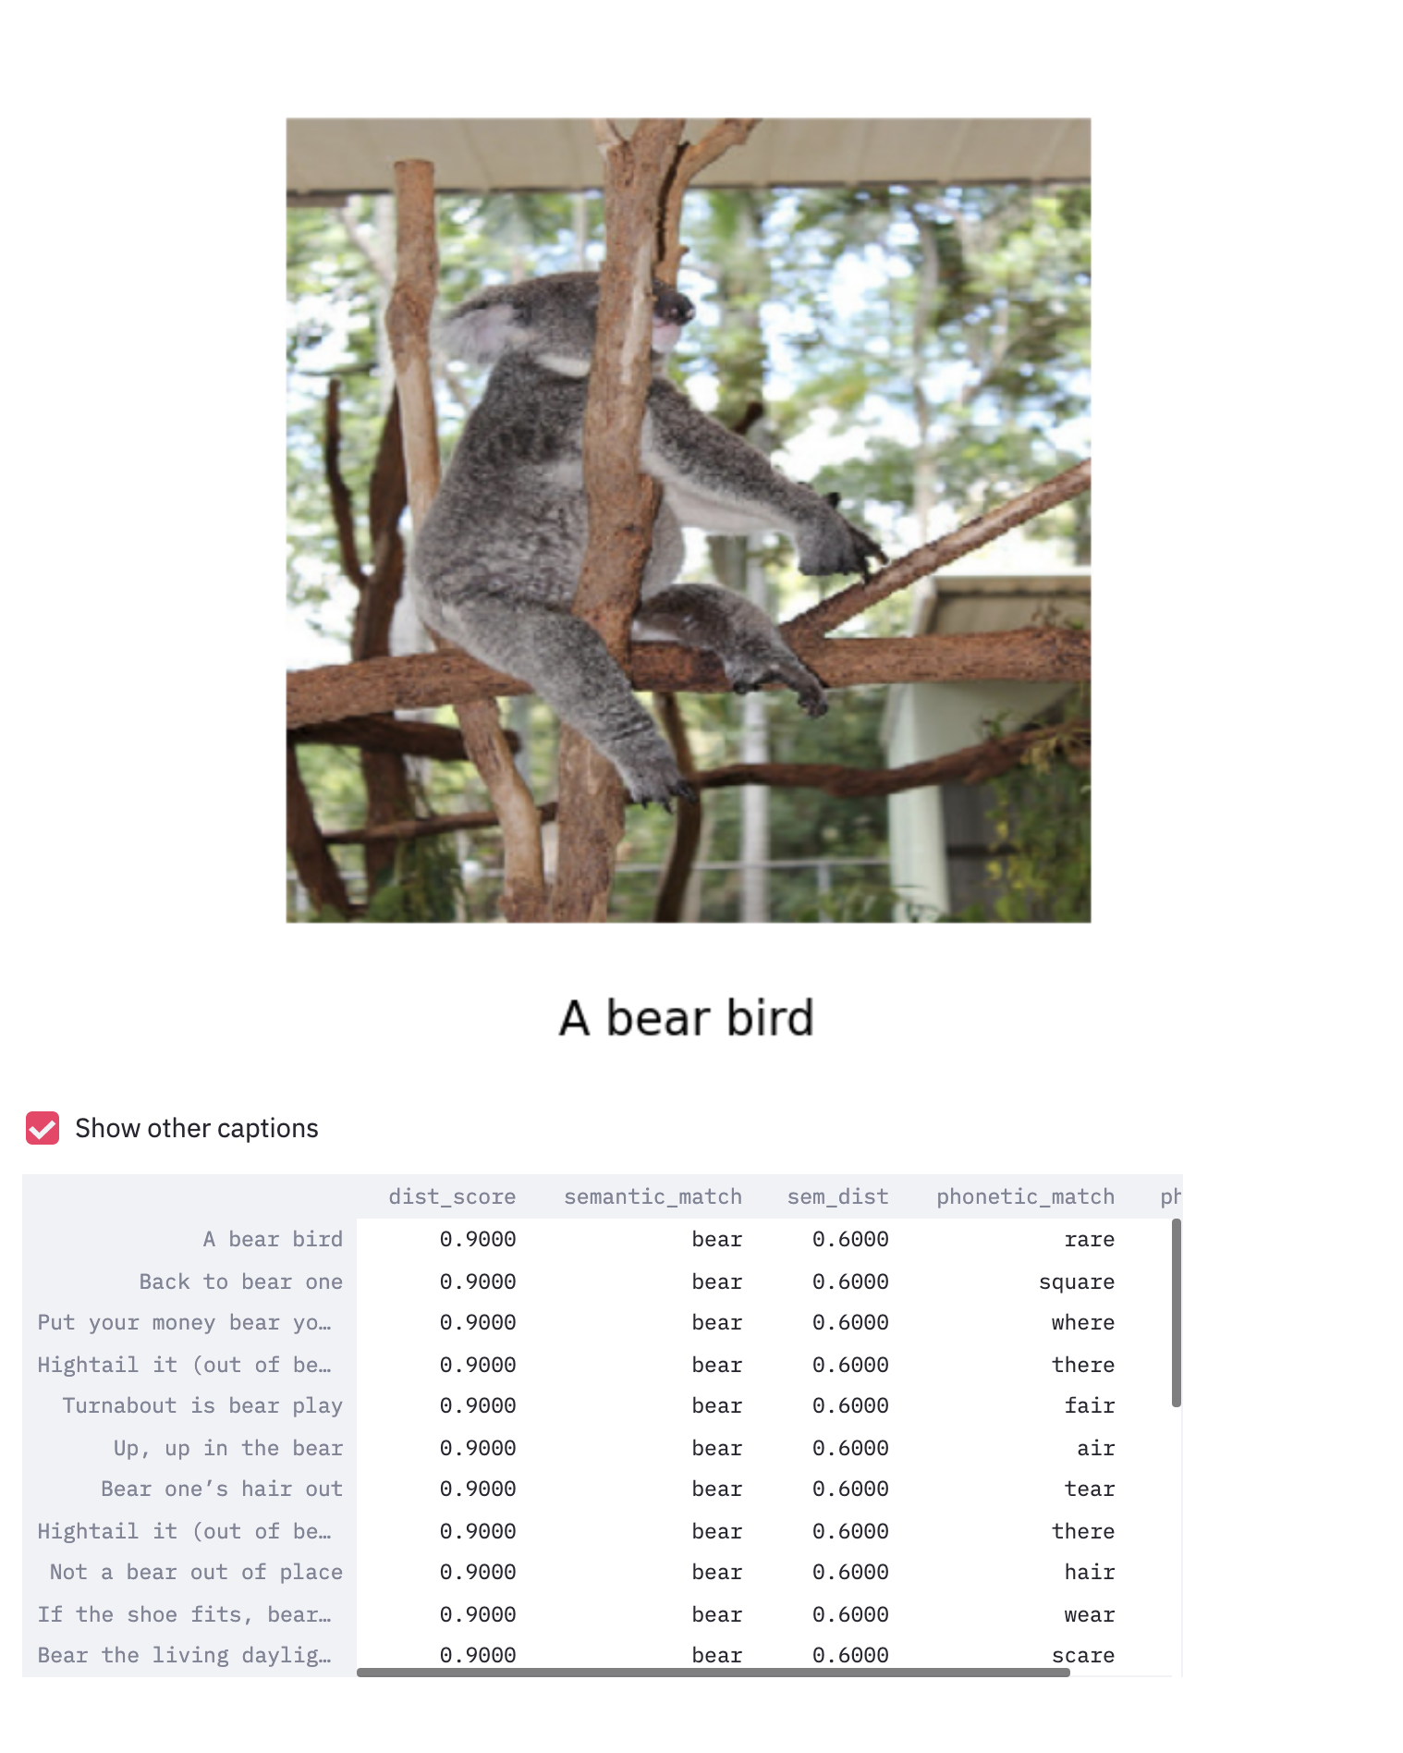

Slide 29
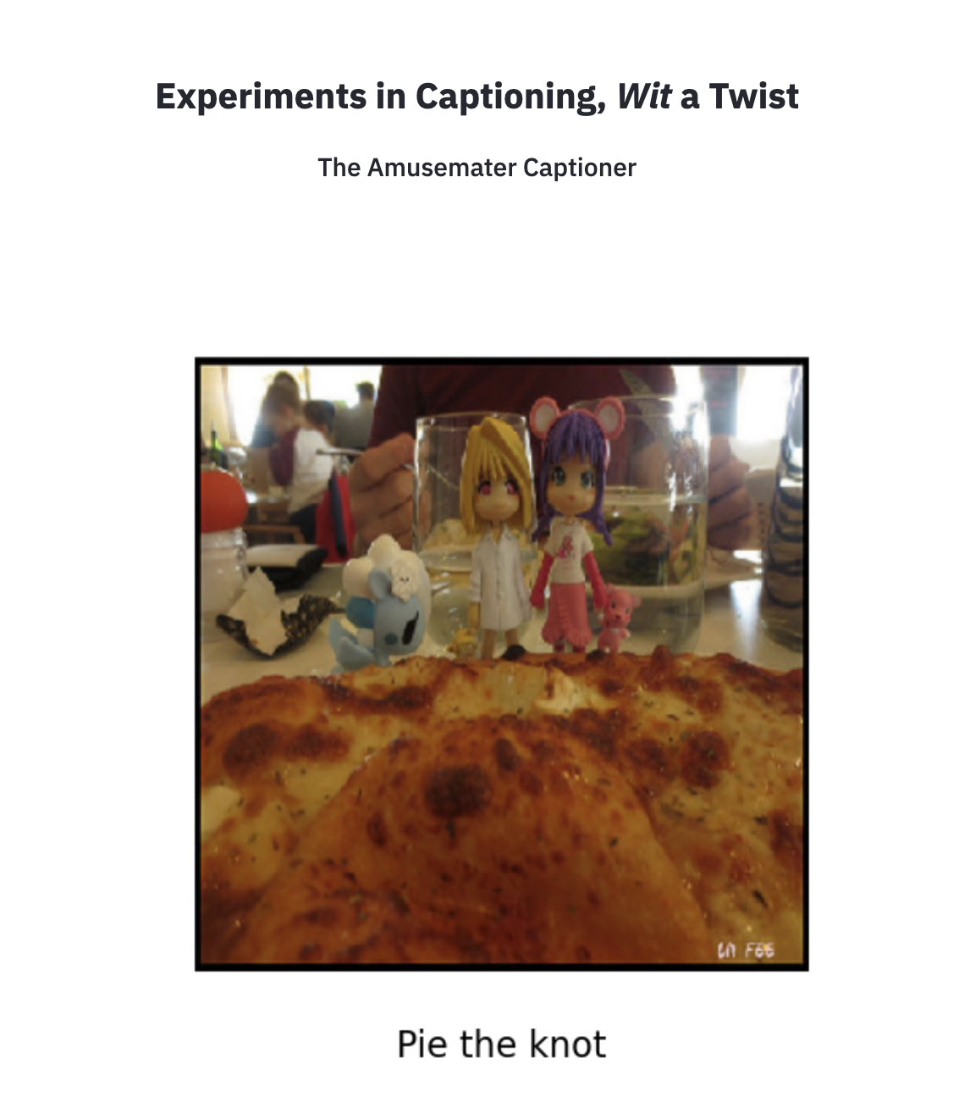

Slide 30
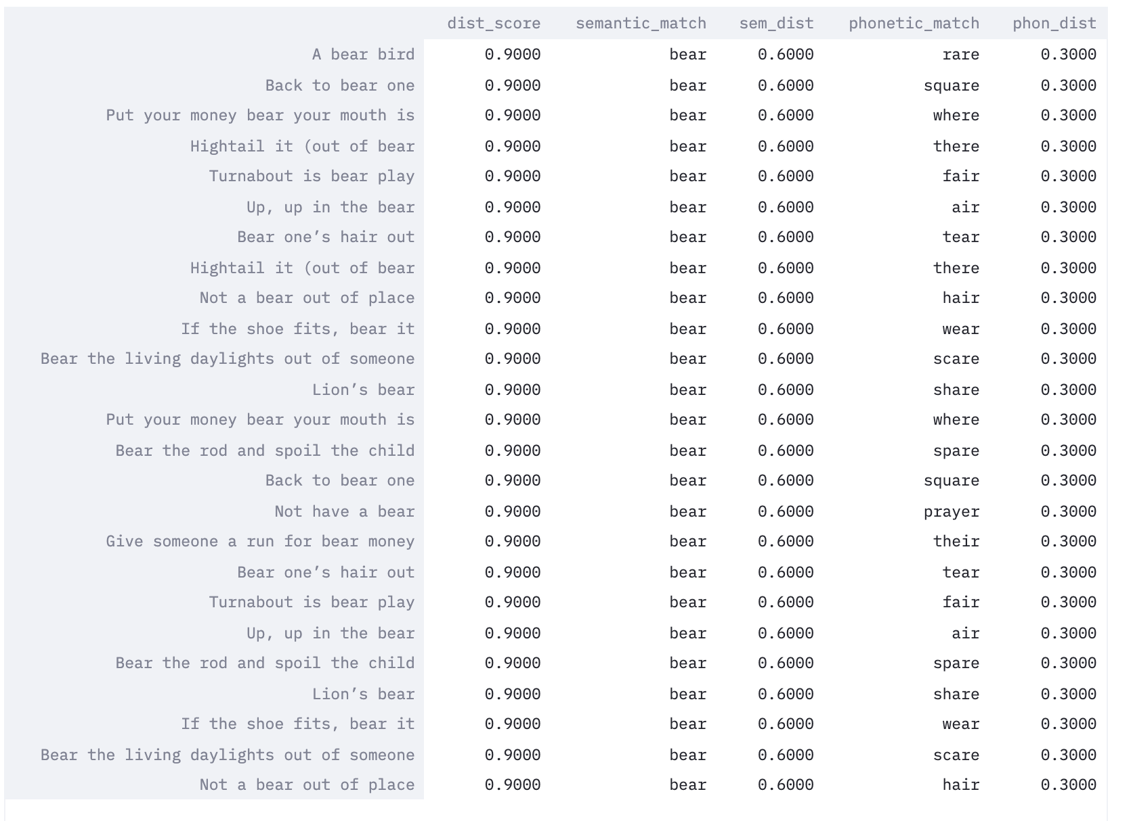

Slide 32
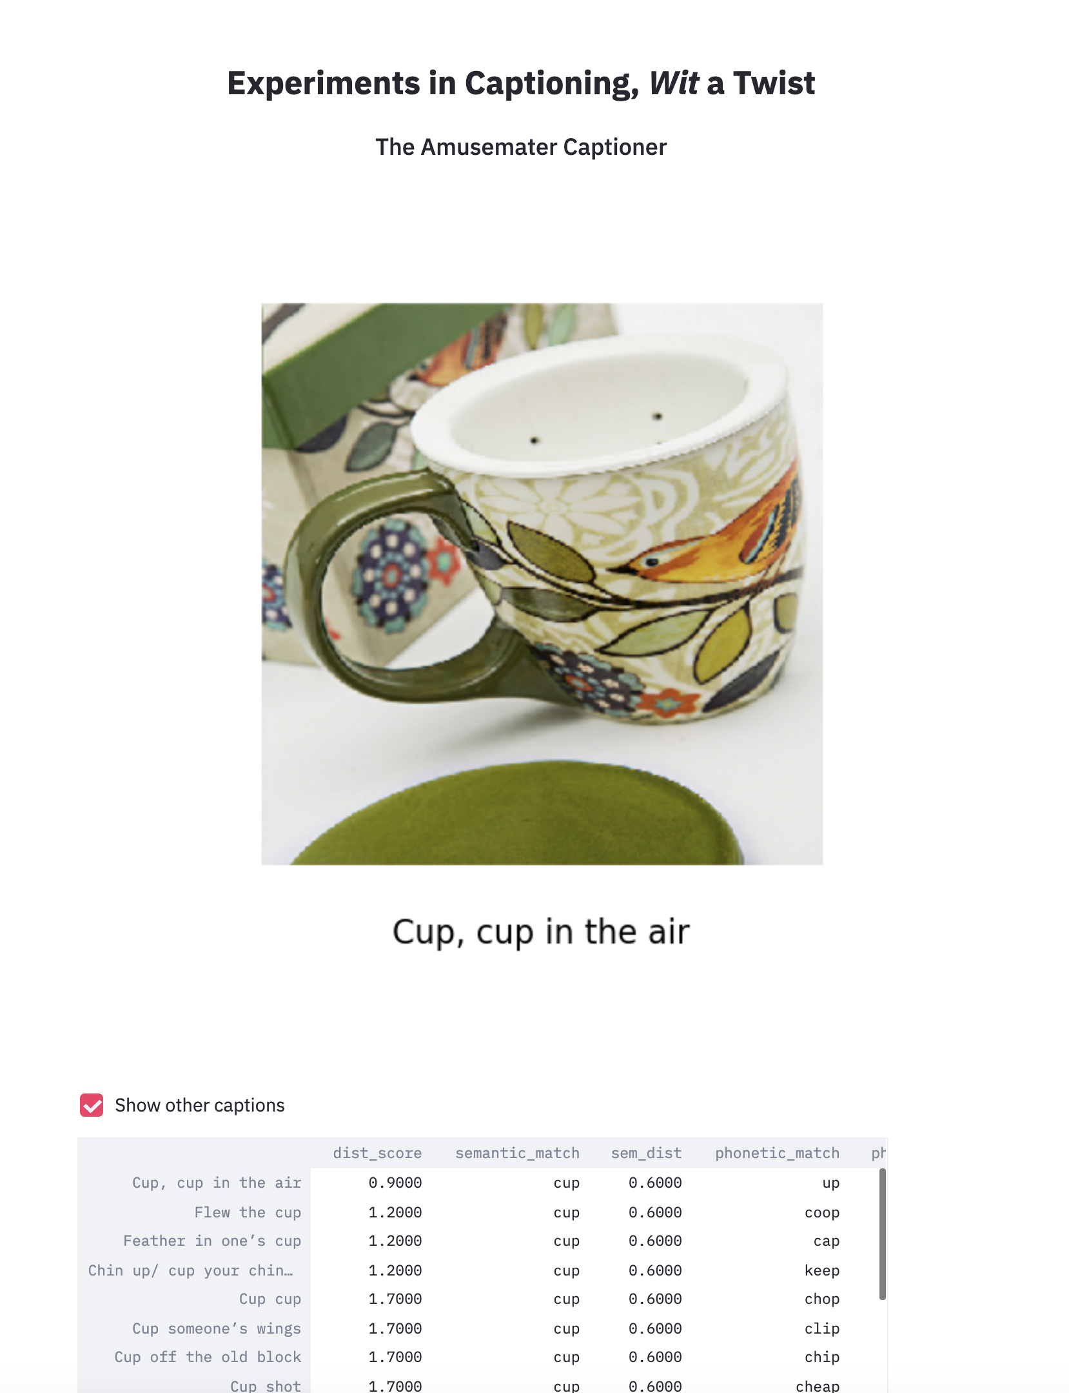

Slide 33
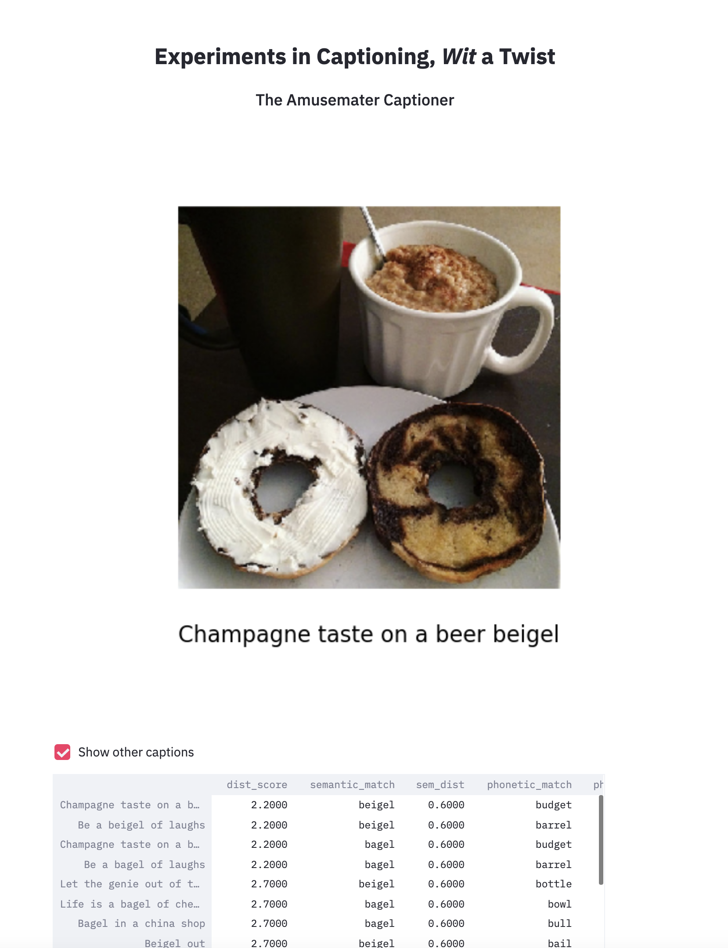

Slide 34
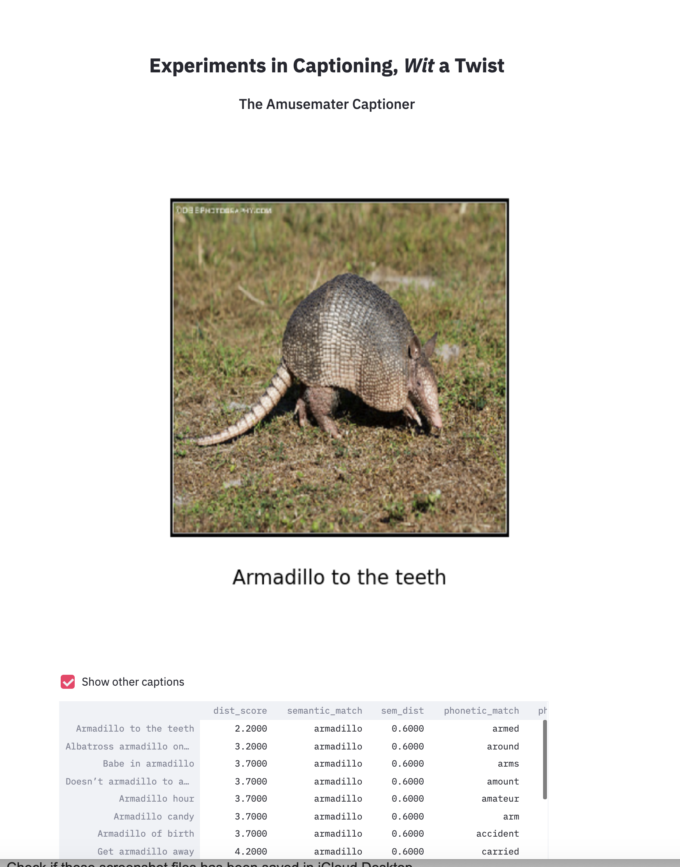

Slide 35
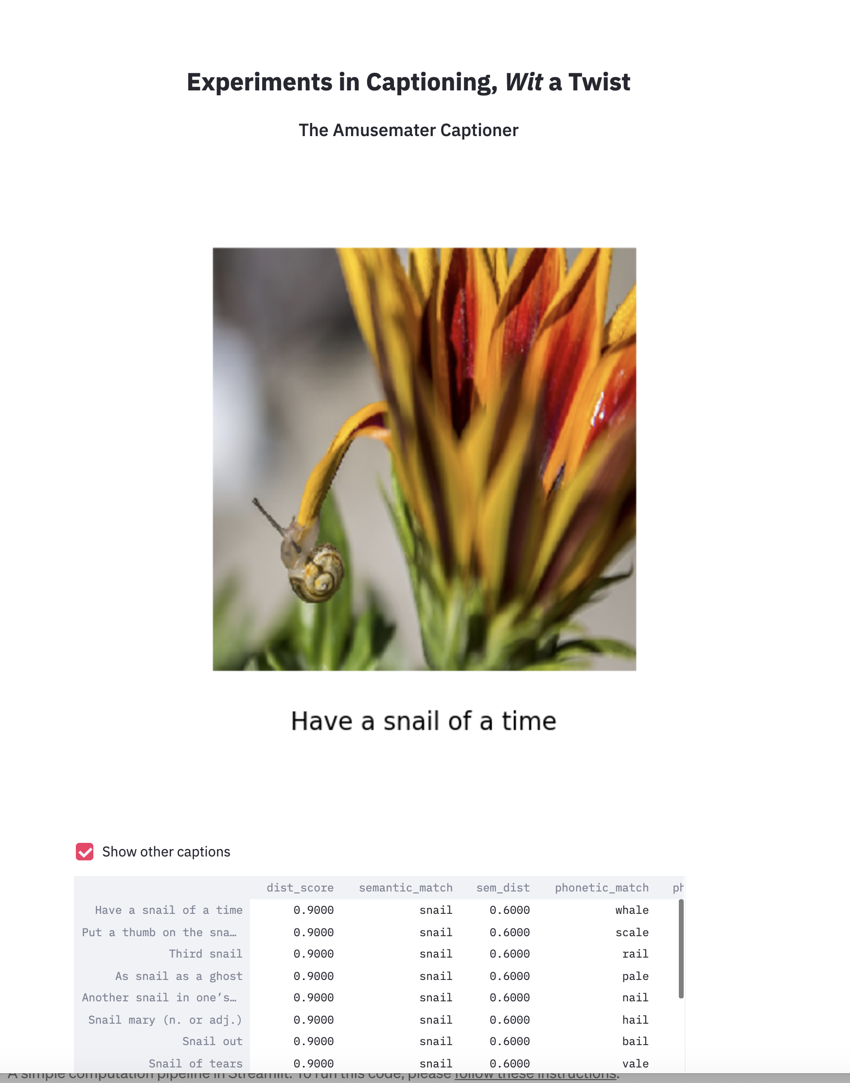

Slide 37
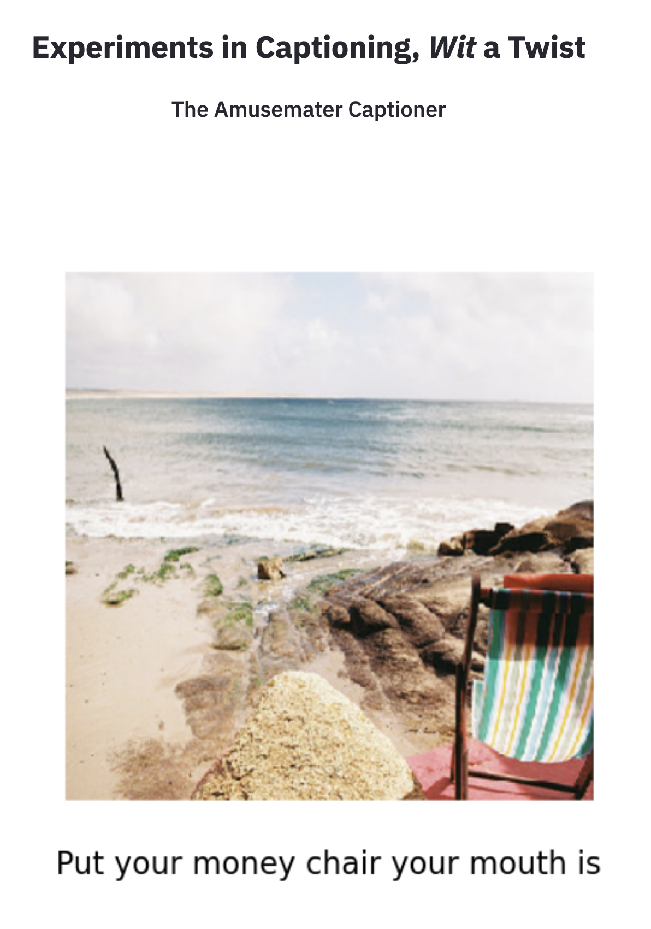

Slide 38
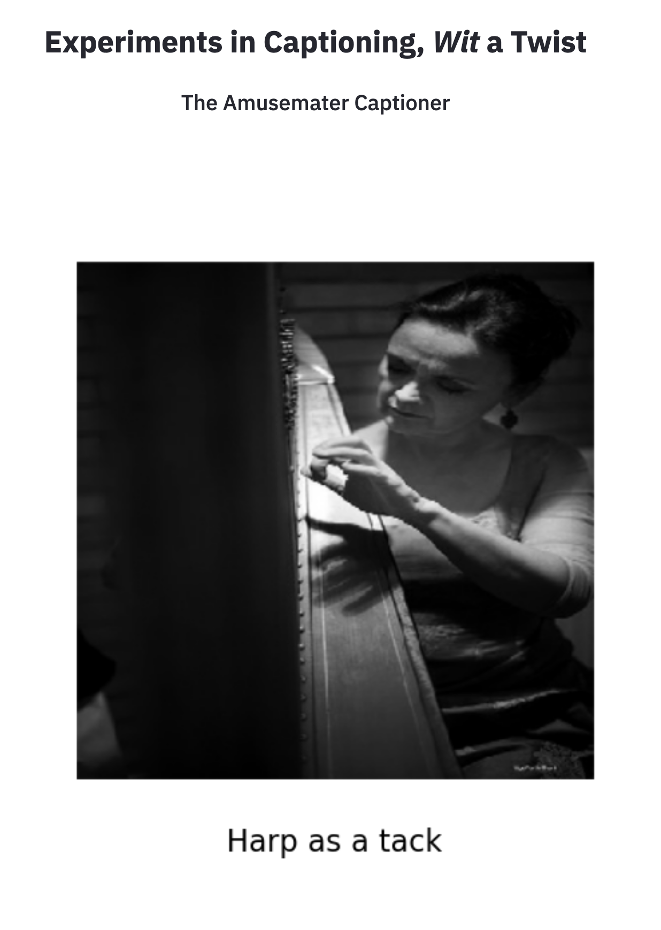

Slide 39
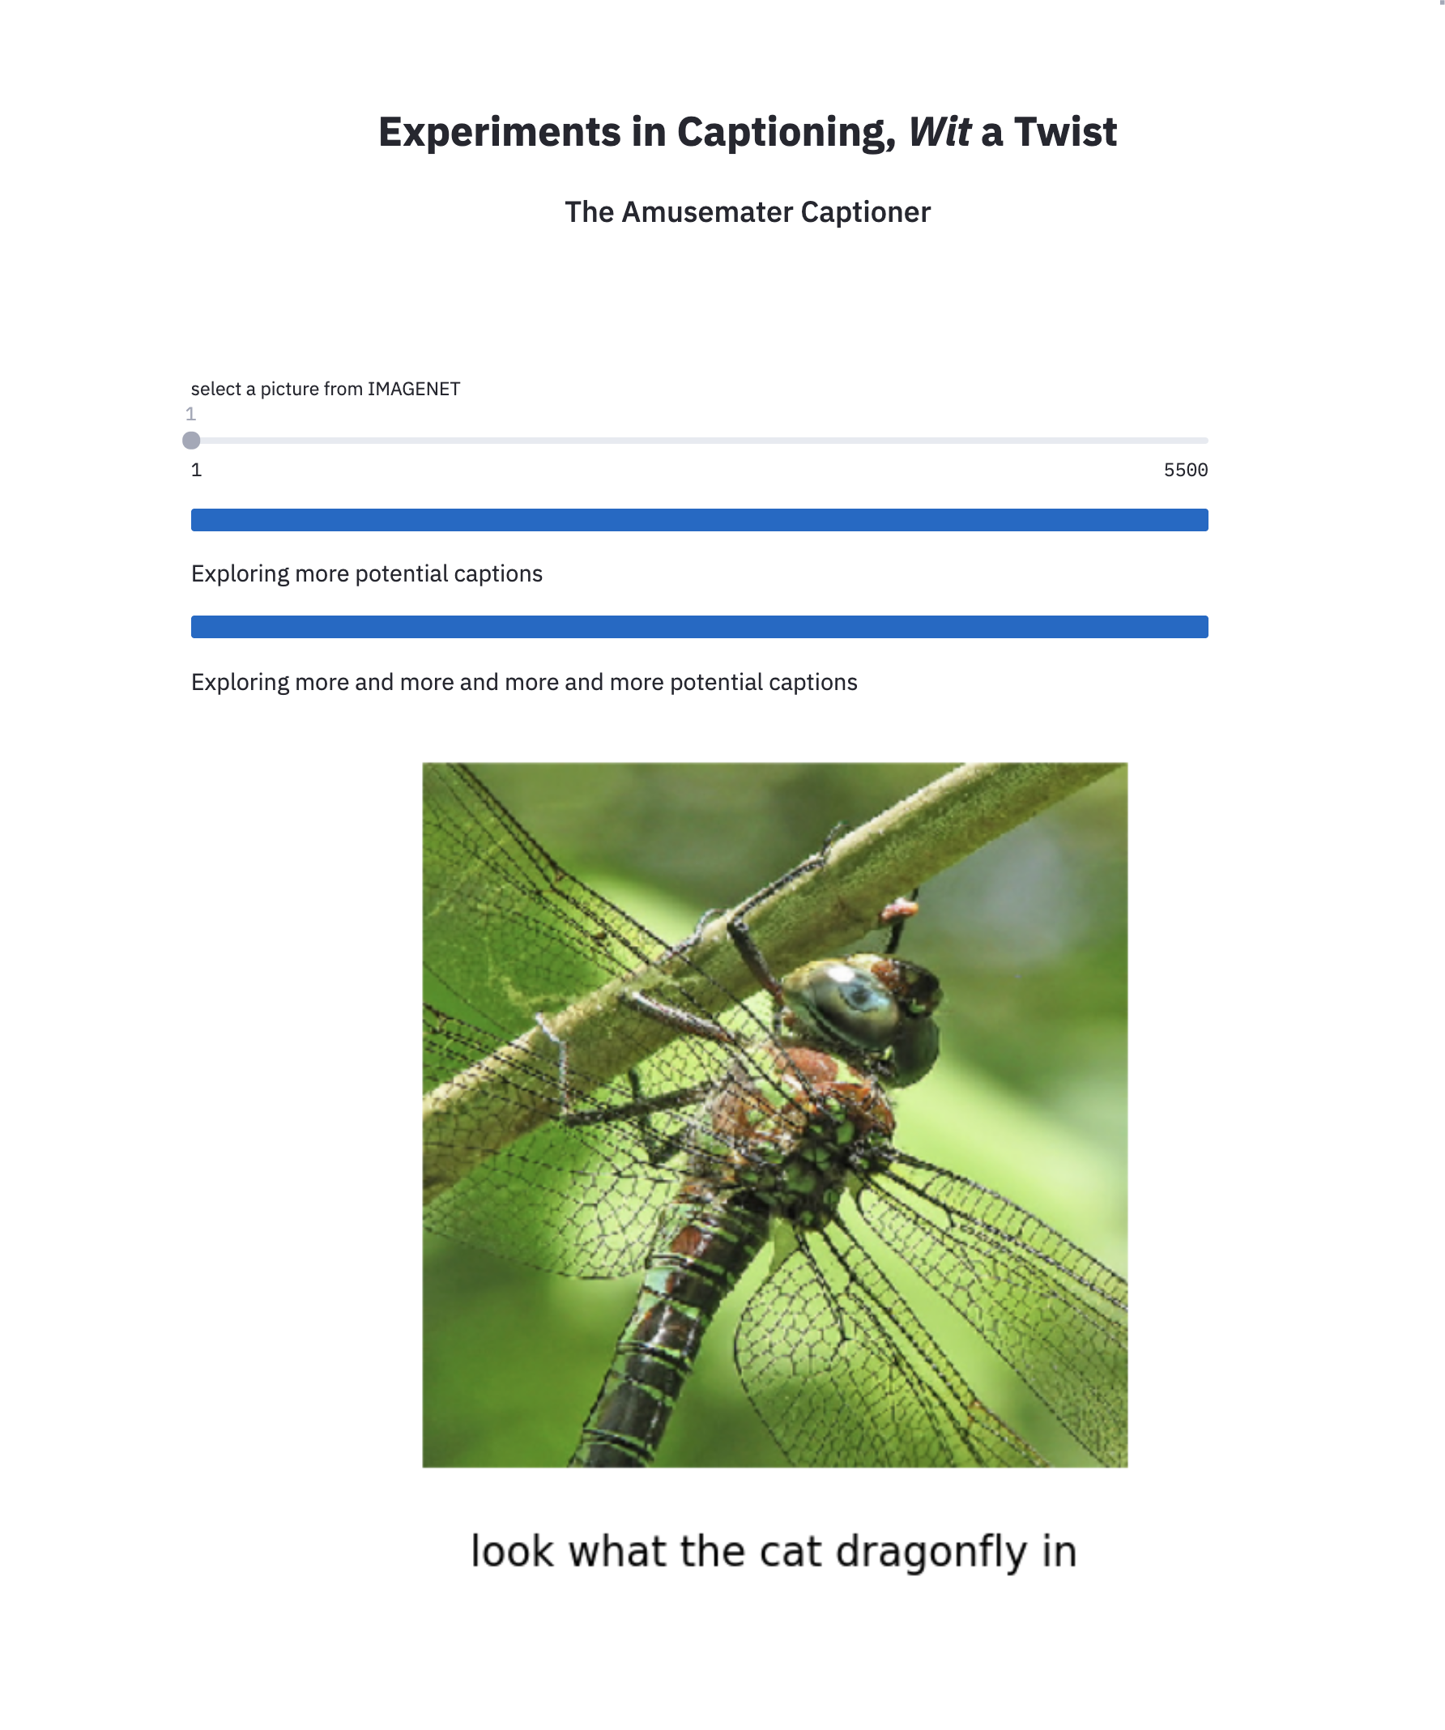

Slide 40
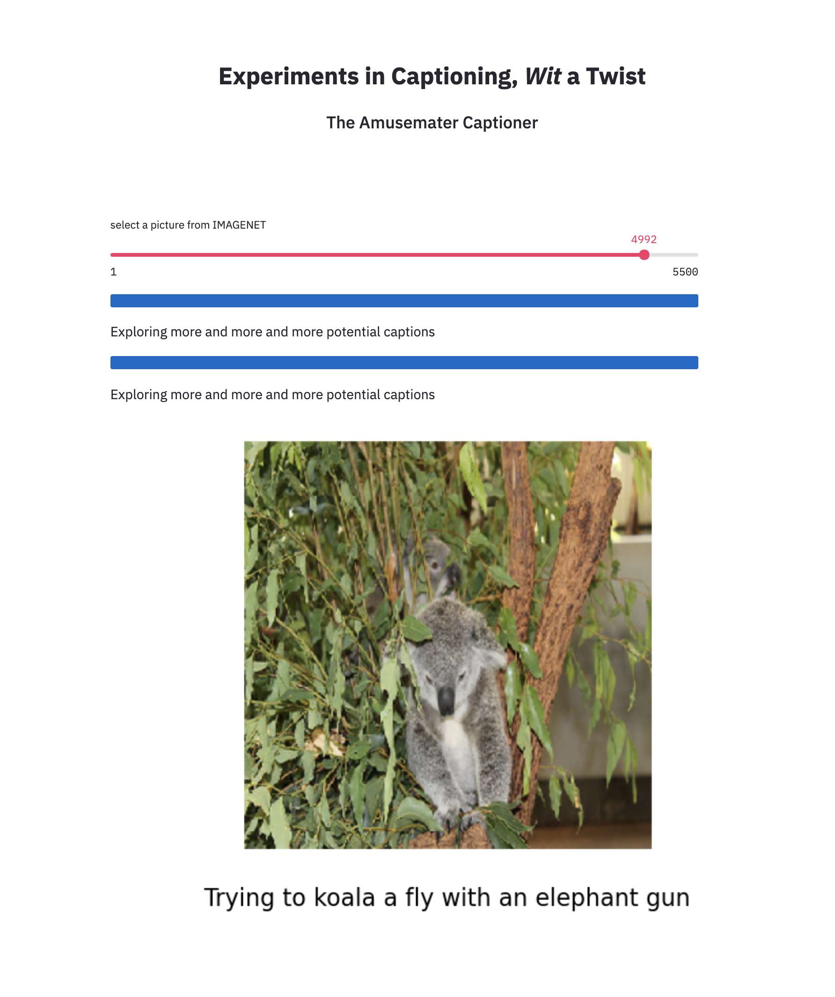

Slide 41
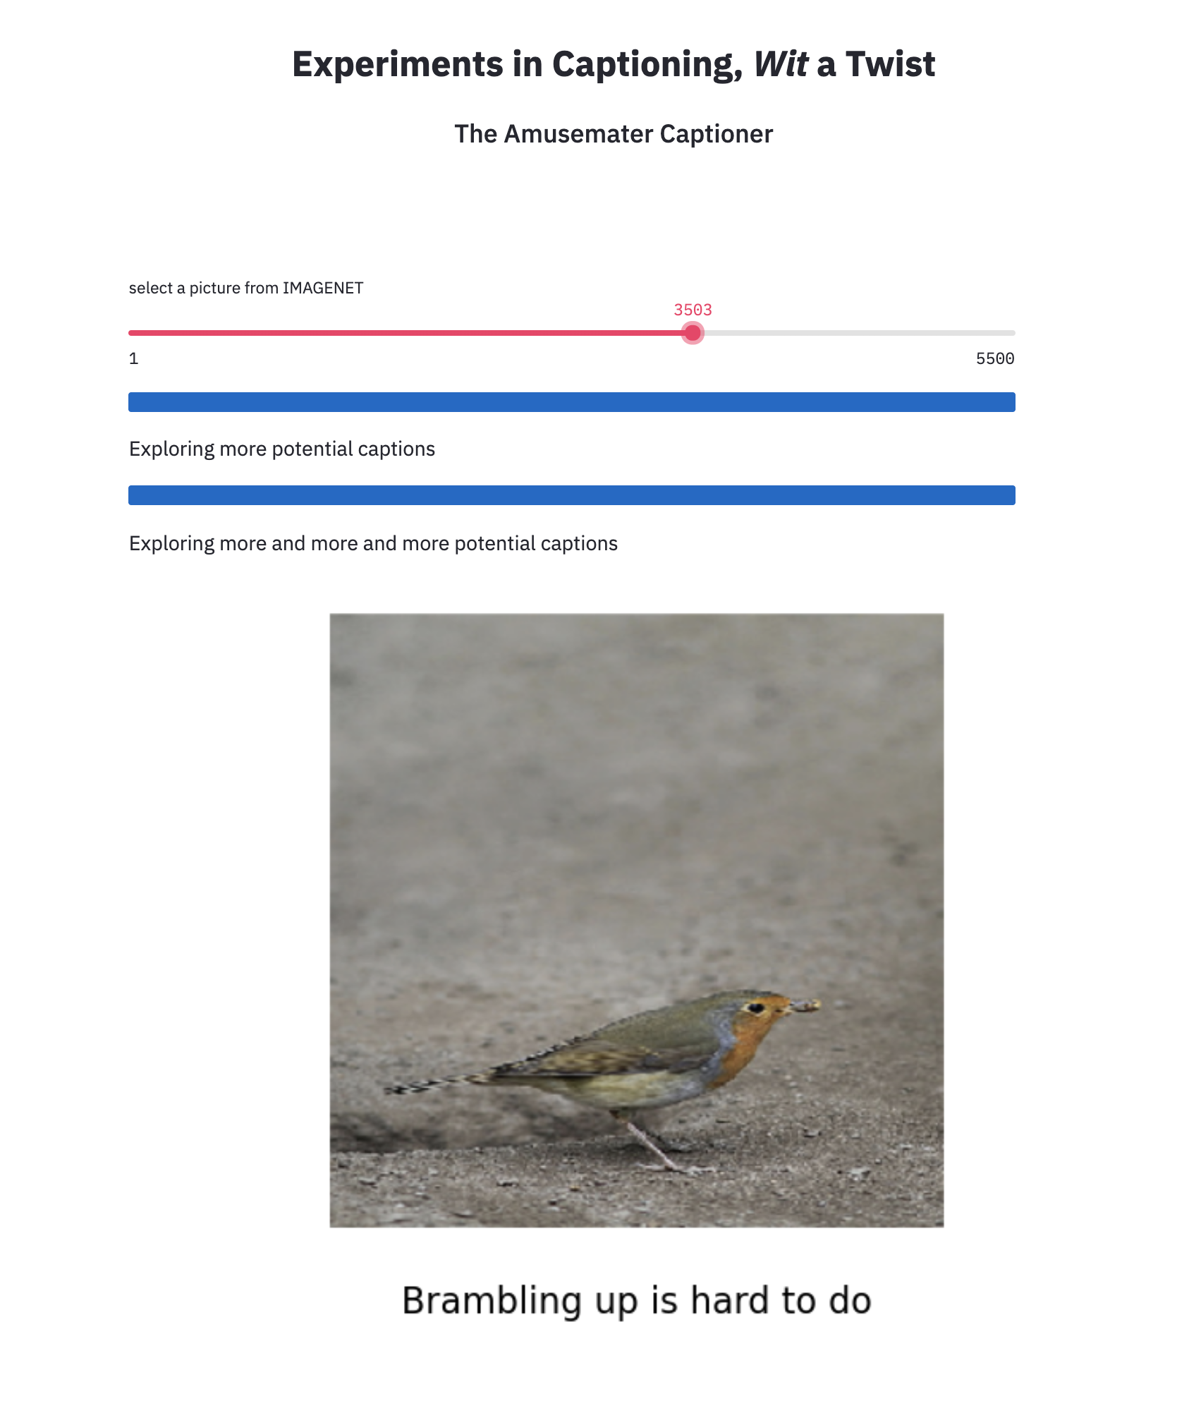

Slide 42
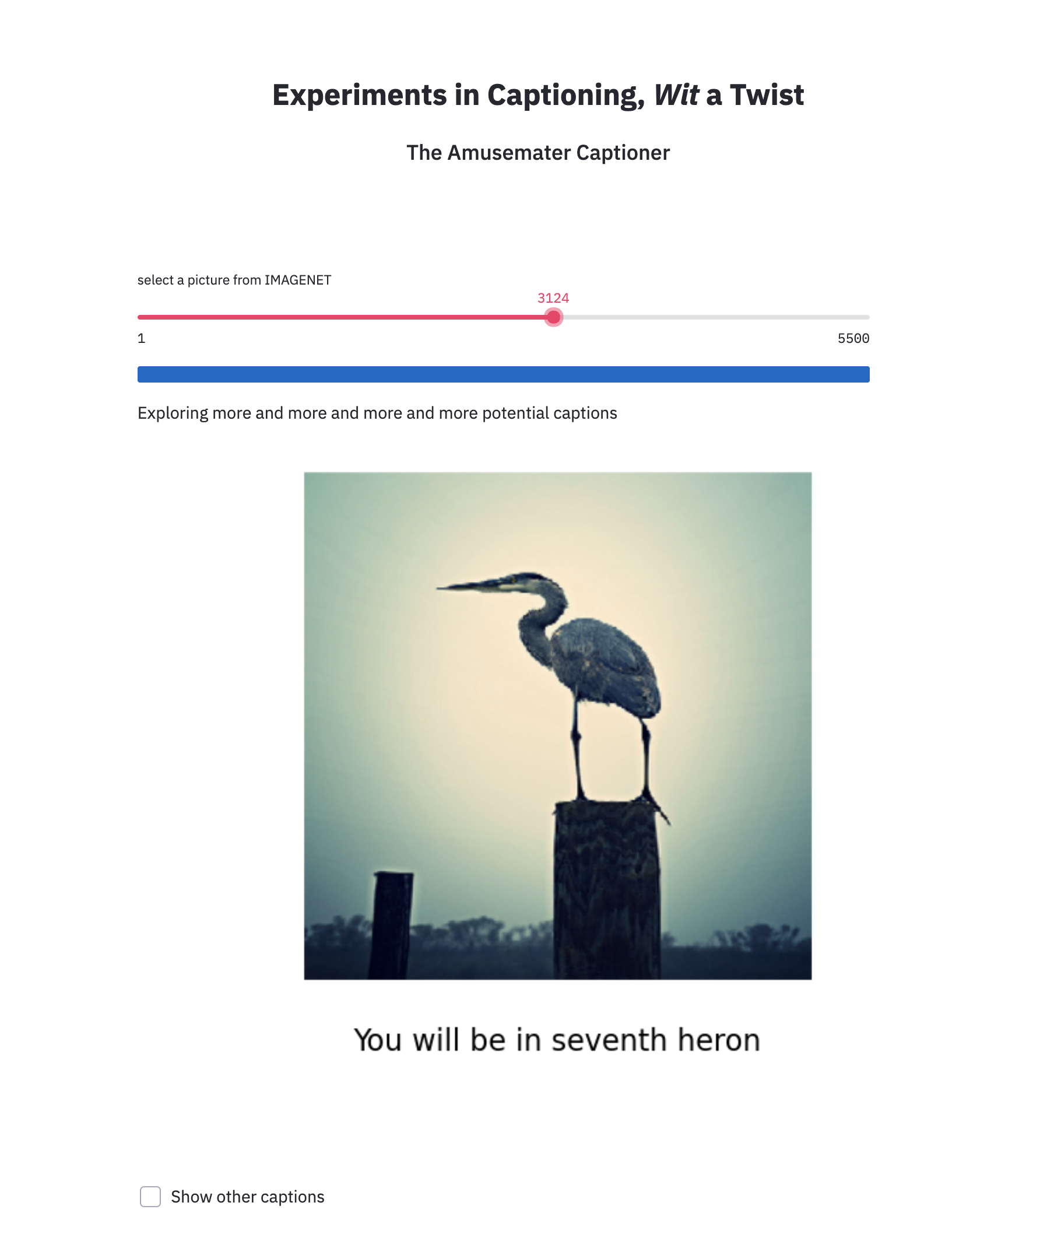

Slide 43
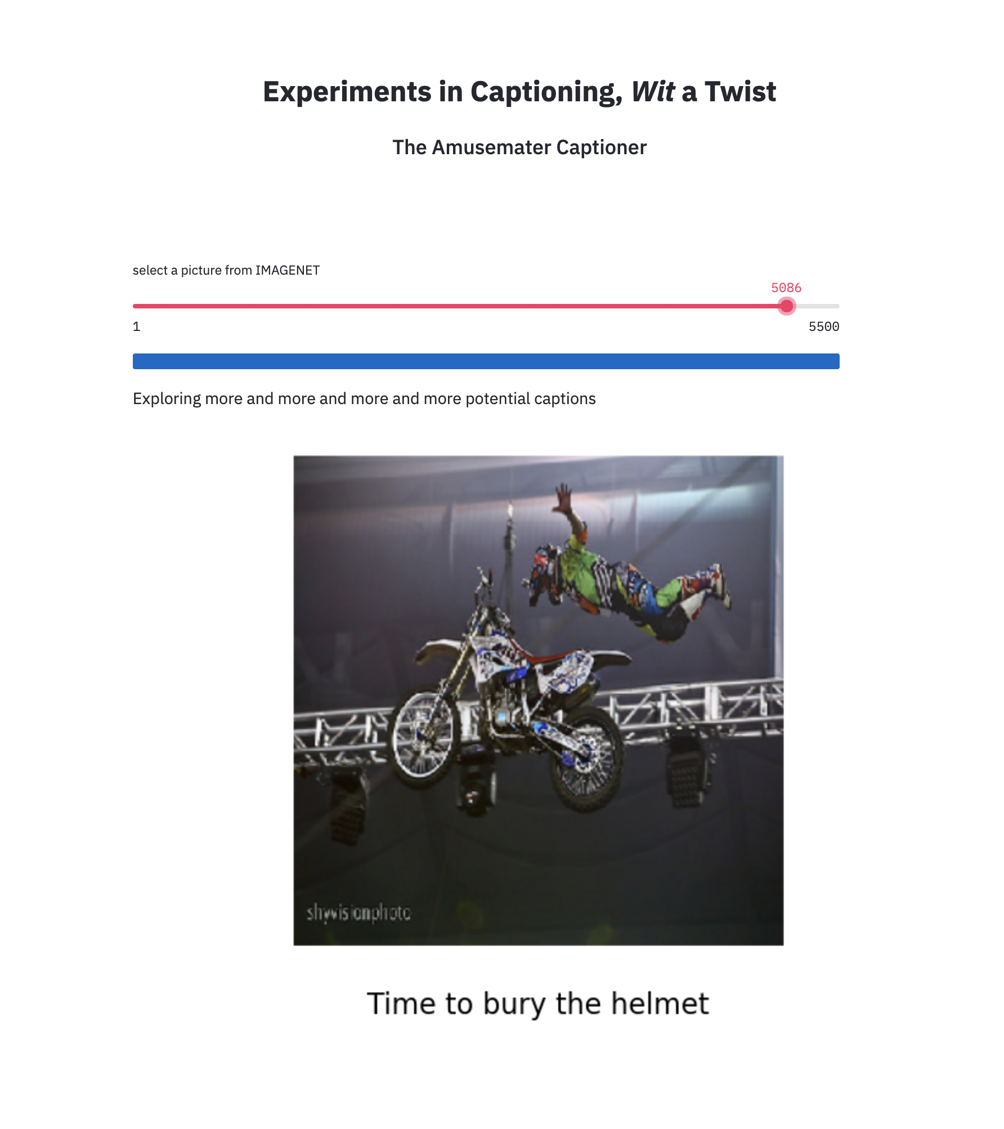

Slide 44
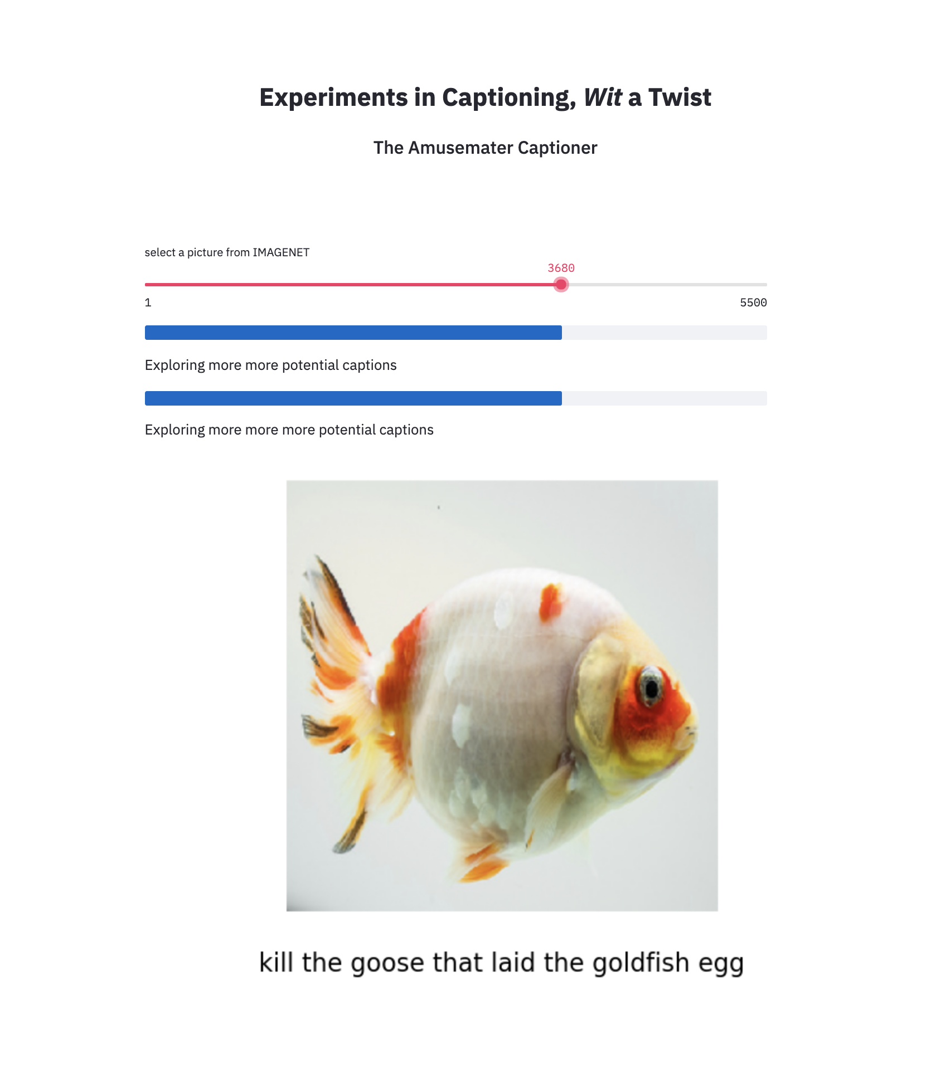

Slide 45
1500 idioms
I am Jayden Smith
I am here because I love to give presentations.
You can find me at @username

Slide 46
HELLO!
Senti
Word
Net corpus
I am Jayden Smith
I am here because I love to give presentations.
You can find me at @username

Slide 47
Preprocessing and precomputation
Scraped and preprocessed idioms
Precomputed lookup dictionaries for fast access to rhymes and to phrases
Precomputed a 55K x 55K correlation matrix of TF-IDF for contextually ‘nearby’ words in SentiWordNet
Designed, developed, and tested, Streamlit app

Slide 48
Interactive app algorithm
Classify (label) the image
Generate a semantic family by finding words semantically related to the image label
Generate a phonetic family (rhymes, assonances, etc) for each semantically related word.
Compute and rank their proximity to their parent
For each word in the phonetic families, find phrases in the idiom list containing the word
Rank the phrases (depending on user settings)
Substitute the phonetically related word with its parent and caption the image
Display in Streamlit app

Slide 49
APIs and pretrained models used
Beautiful Soup
Xception pre-trained neural for image classificiation
NLTK, Gensim, Sklearn, and misc. phonetics packages
Streamlit

Slide 50
Not yet implemented
HELLO!
Contextually ‘nearby’ words
(not synonyms)
Not yet implemented
I am Jayden Smith
I am here because I love to give presentations.
You can find me at @username

